Slide 1
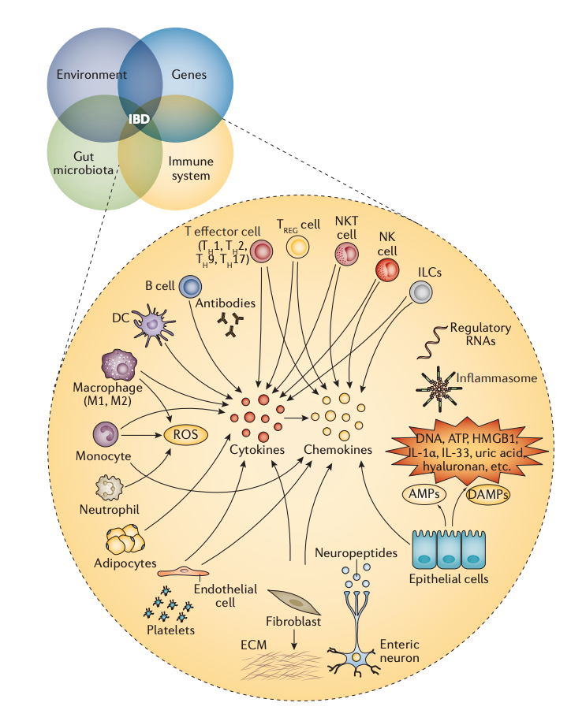
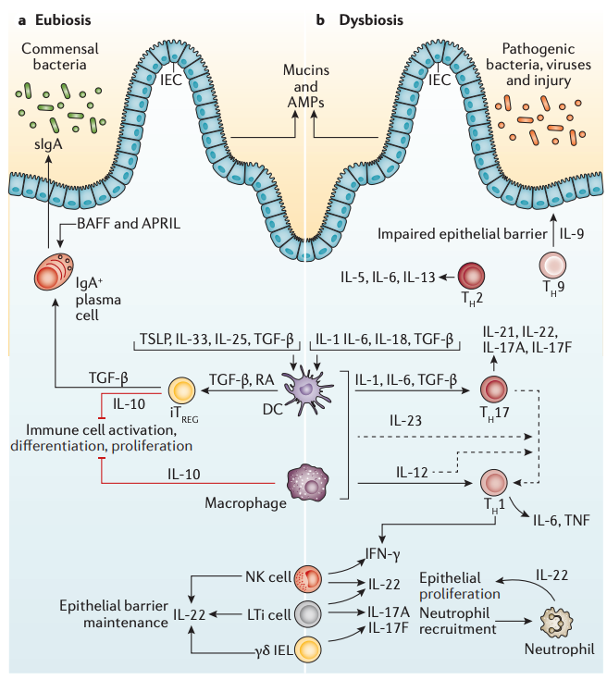
Patophysiology of IBD
Characterised by an epithelial barrier impairment, which disrups inmume system homeostasis and disbalances the cytokine production which ultimately leads into an state of chronic inflammation
Complex disease driven by:
Enviromental Factors
Genetic Factors
Inmune System Predisposition

Slide 2
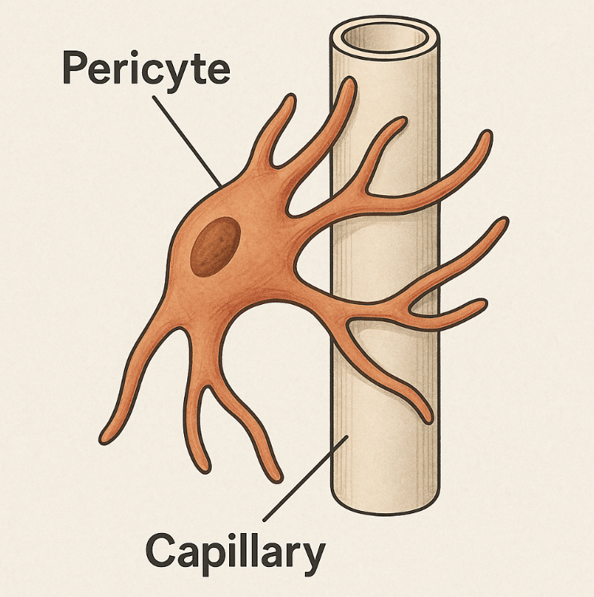
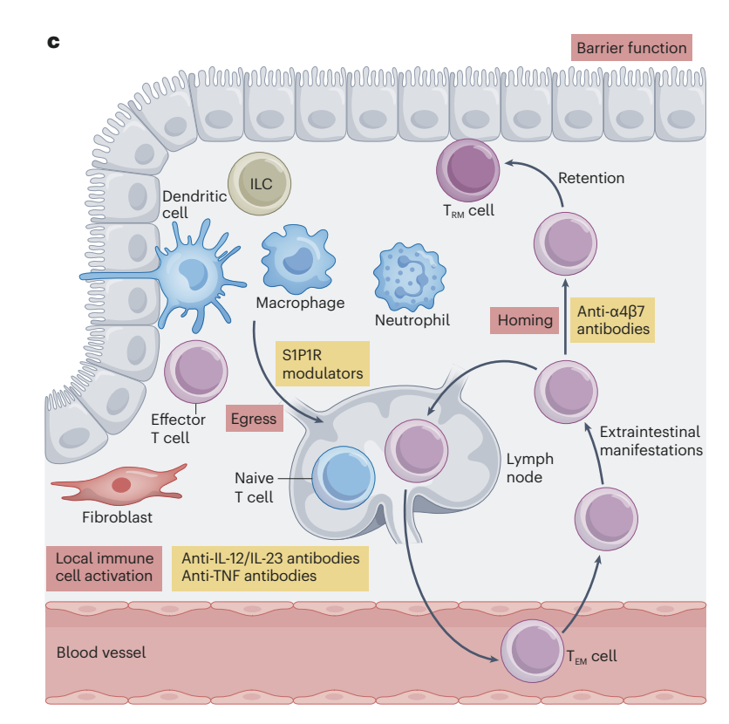
Pericytes and its role on IBD
Possible role in IBD:
Pericytes dysfunction increase endothelial barrier permeability, increasing the flow of inmune cells into the tissue
Act as important signaling cell, producing pro-inflammatory molecules that attract and activate effector cells
Pericytes:
Vascular-associated fibroblast-like stromal cells
Key regulators of vascular integrity and immune cell recruitment/diapedesis
Indirect promoters of IBD via strong communication with other cell types

Slide 3
Why use Single Cell
Single-Cell RNA seq | Bulk RNA seq
Allows to isolate pericytes and get their gene expression footprint | Pericytes gene expression footprint would get diluted
Possible to distinguish different pericytes cell states | Not possible to distinguish different cell types or cell states
Allows Cell-to-Cell Communication Analysis | Not possible to perform Cell-to-Cell Communication Analysis

Slide 4
Why use Single Cell
Single-Cell RNA seq
Allows to isolate pericytes and get their gene expression footprint
Possible to distinguish different pericytes phenotypes
Allows Cell-to-Cell Communication Analysis
OBJECTIVES

Slide 5
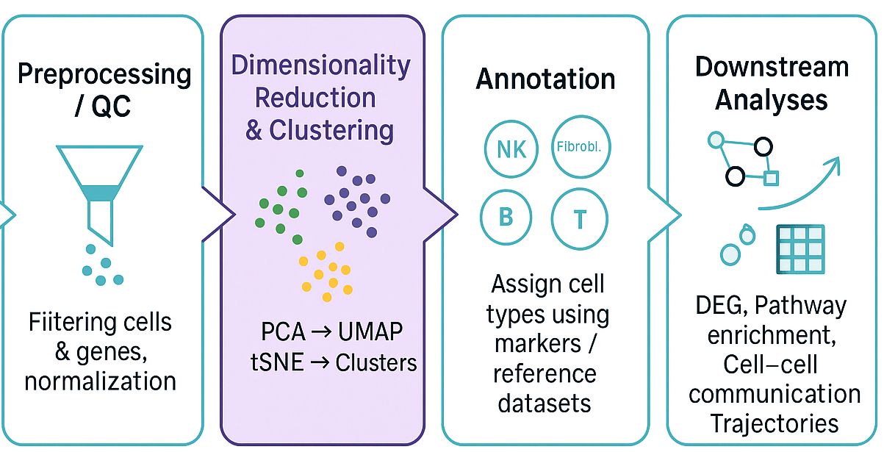
Single Cell Workflow
Objective
Complex, high dimensional and apparently illegible single-cell data
Clear, interpretable insights with biological relevance
PCA, UMAP, Integration and Clustering
Integration

Slide 6
Single Cell Workflow
Objective
Complex, high dimensional and apparently illegible single-cell data
Clear, interpretable insights with biological relevance
Preprocessing:
Remove low quality cells (Low genes detected, reads, high MT %...)
Choose Highly variable genes (HVG) to reduce noise
Normalize and scale to be able to run meaningful comparisons
PCA, UMAP, Integration and Clustering
Integration

Slide 7
Single Cell Workflow
Objective
Complex, high dimensional and apparently illegible single-cell data
Clear, interpretable insights with biological relevance
Dimensionality reduction and clustering:
PCA for extracting the main sources of variation out of the data, UMAP for plotting high dimensional data in 2D
Integrate data to minimize batch effects
Use dimensional reductions to find clusters
PCA, UMAP, Integration and Clustering
Integration

Slide 8
Single Cell Workflow
Objective
Complex, high dimensional and apparently illegible single-cell data
Clear, interpretable insights with biological relevance
Annotation:
Use previously define clusters and marker genes to determine different celltypes
PCA, UMAP, Integration and Clustering
Integration

Slide 9
Single Cell Workflow
Objective
Complex, high dimensional and apparently illegible single-cell data
Clear, interpretable insights with biological relevance
Downstream Analyses:
Once data is prepared, we can run multiple analysis to extract biological conclusions
This includes DEG, FGSEA, DCATS, Cell-Cell communication, Cell Trajectories (TSCAN)…
PCA, UMAP, Integration and Clustering
Integration

Slide 10
Data Structure and Attempted Analyses
Objective
Starting with 44 Samples (32 different patients):
15 Inflamed
11 Non Inflamed
18 Healthy (CRC patients)
Explore differences between Healthy (Non Inflamed, Healthy) and Inflamed tissue
 | Comparison Design | Issue
Option 1 | Inflamed Vs Non Inflamed (Correcting by patient) | Low number of Non Inflamed cells (too low DEGs)
Option 2 | Inflamed Vs Healthy + Non Inflamed (Correcting by Patient / Batch) | Low number of “Anchor” cells (cells from both conditions present in the same Batch / Patient), too strong correction + Assuming Healthy = Non Inflamed
Option 3 | Inflamed Vs Healthy (No correction) | Strong Batch effects (not possible to correct by Patient)

Slide 11
Data Structure and Attempted Analyses
Objective
Starting with 44 Samples (32 different patients):
15 Inflamed
11 Non Inflamed
18 Healthy (CRC patients)
Explore differences between Healthy (Non Inflamed, Healthy) and Inflamed tissue
 | Comparison Design | Issue
Option 1 | Inflamed Vs Non Inflamed (Correcting by patient) | Low number of Non Inflamed cells (too low DEGs)
Option 2 | Inflamed Vs Healthy + Non Inflamed (Correcting by Patient / Batch) | Low number of “Anchor” cells (cells from both conditions present in the same Batch / Patient), too strong correction + Assuming Healthy = Non Inflamed
Option 3 | Inflamed Vs Healthy (No correction) | Strong Batch effects (not possible to correct by Patient)

Slide 12
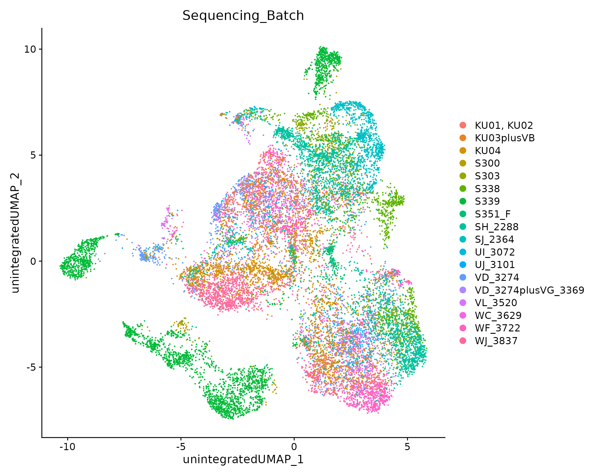
Batch Effects and Harmony Integration
Sequencing Batch
Often in Single Cell gene expression is influenced by technical factors with no Biological meaning, these are known as Batch effects
Using mathematical approaches, we can distinguish true biological variation from technical noise (batch effects). This process is referred to as integration.

Slide 13
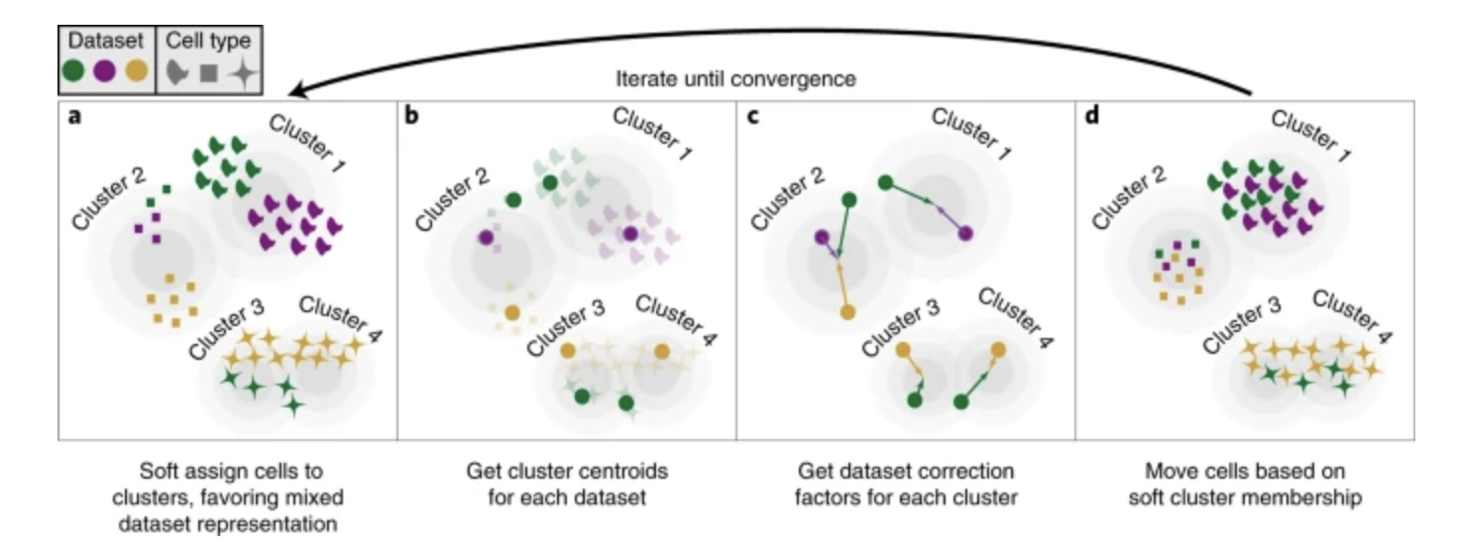
Batch Effects and Harmony Integration
Harmony Integration:
Works on the PCA space, it iteratively cluster cells, detects batch-specific structure and shift the embeddings to minimize the batch effects
Batches that contain cells from multiple conditions help Harmony avoid removing real biology, since they provide overlap between technical and biological variation.
Why Harmony?
Fast and Scalable
Handles Strong Batch effects
Robust when batches have unbalanced conditions
Harmony workflow. [Fan, J. et al.]

Slide 14
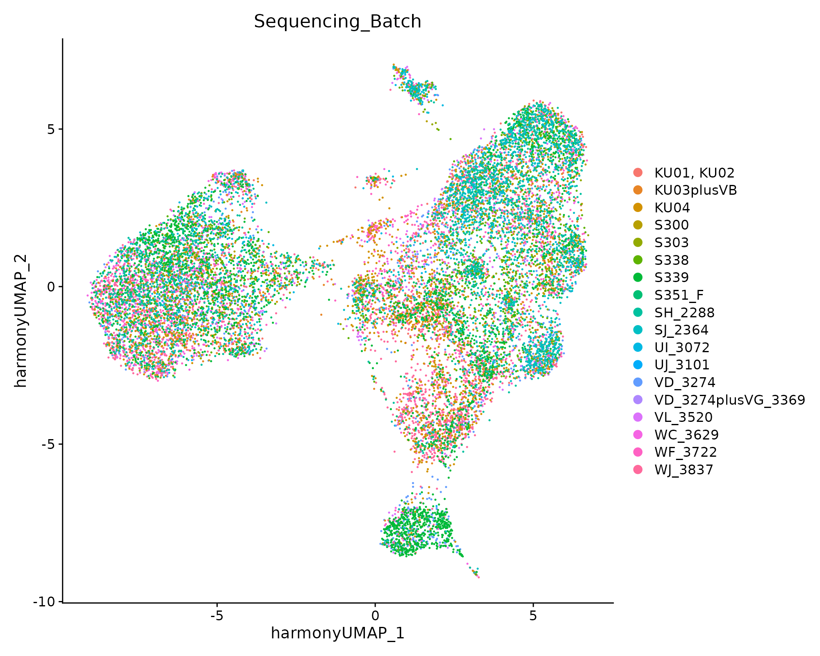
Batch Effects and Harmony Integration
Before
After
Sequencing Batch
Sequencing Batch

Slide 15
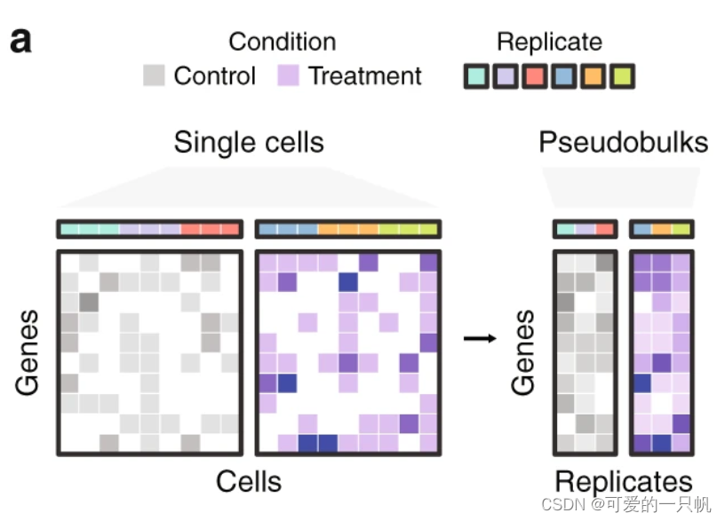
Differentially Expressed Genes (DEGs)
Pseudobulk analysis: Aggregate expression per replicate and DESeq2 for determining DEGs
Due to the experimental design, it is not possible to correct by patient/Sequencing batch, as there are not enough “anchors”.

Slide 16
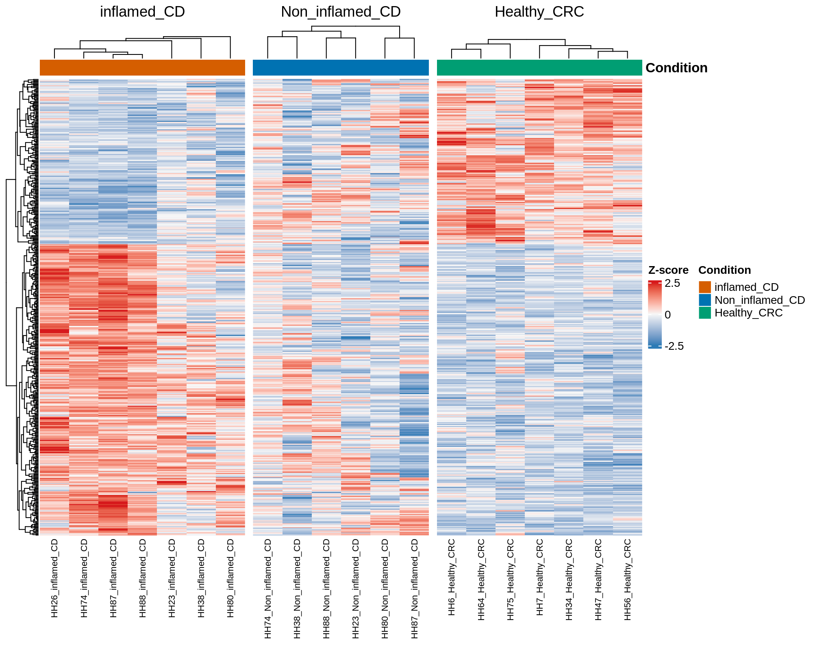
Differentially Expressed Genes (DEGs)
Recall we are dealing with possible Batch effects
Inflammation is a complex process that can manifest through different pathways
Check DEGs INDIVIDUALLY
Look for expression patterns
Study Batch effects

Slide 17
Differentially Expressed Genes (DEGs)
DEG analysis shows Healthy and Inflamed associated genes
We can Identify “Inflammation associated genes” and “Healthy associated genes”
Although batch effects are present, they do not account for the major patterns observed in gene expression; the dominant signal reflects true biological differences
Heatmap of DEG (Inflamed vs Healthy, padj < 0.05). Splitted by condition

Slide 18
Differentially Expressed Genes (DEGs)
DEG analysis shows different subgroups in the inflamed condition
Within the inflamed samples, we observe two distinct subgroups, which may reflect different intensities or underlying mechanisms of inflammation
Heatmap of DEG (Inflamed vs Healthy, padj < 0.05). Splitted by condition

Slide 19
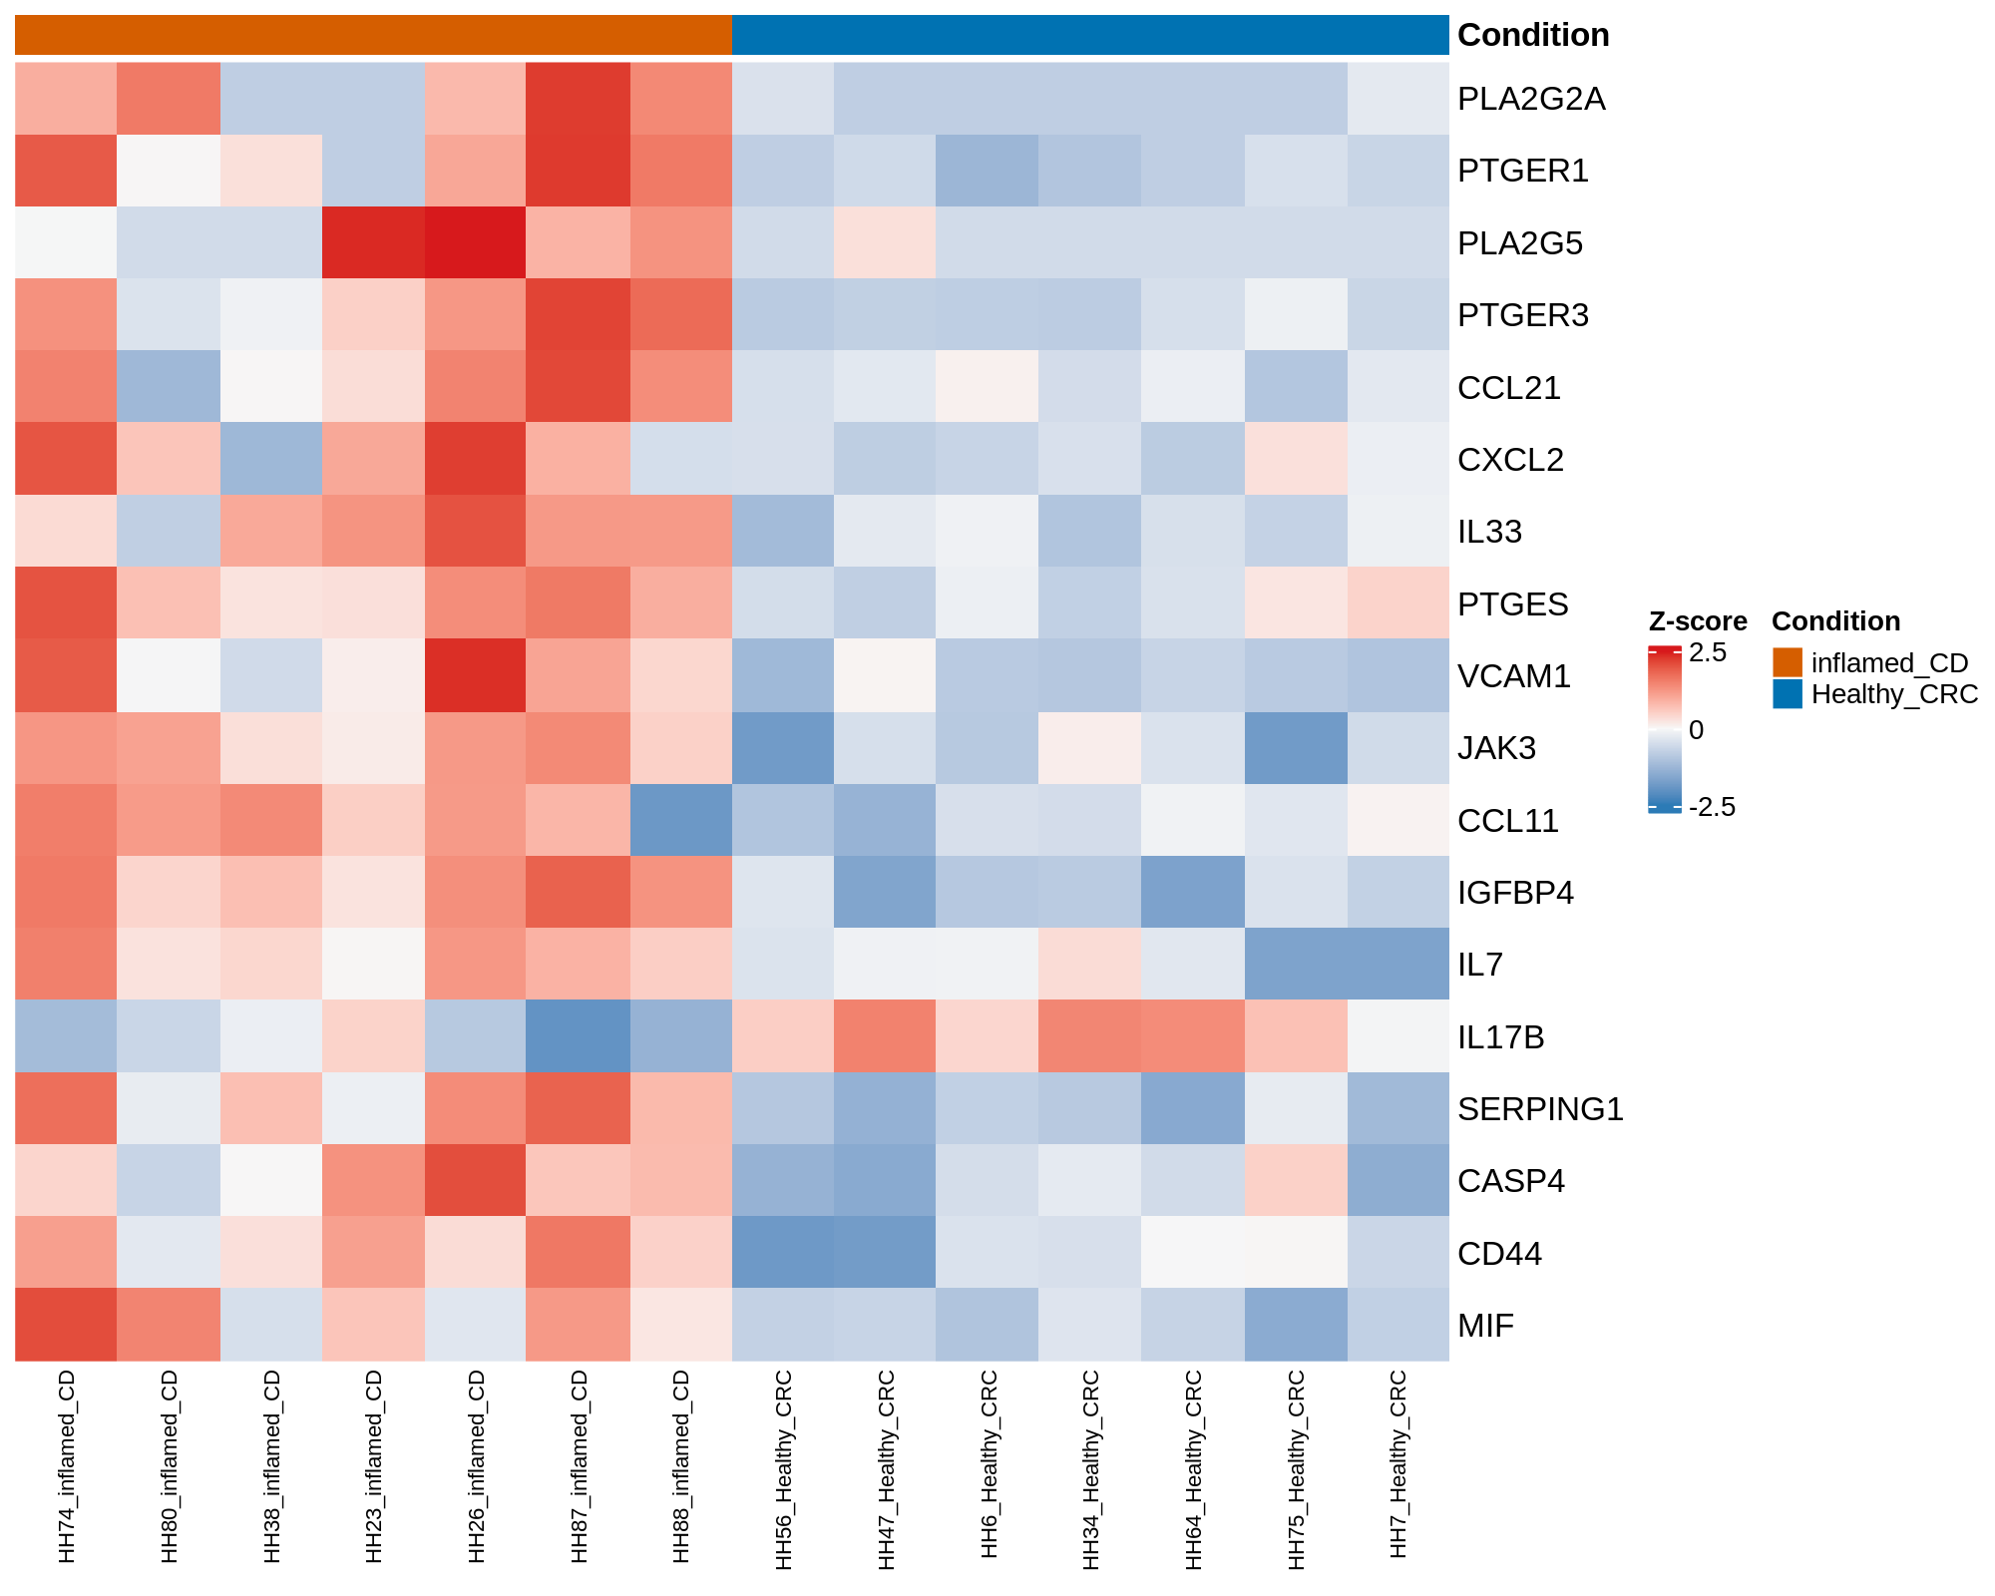
Differentially Expressed Genes (DEGs)
If we stick to “IBD relevant genes”, we still see a similar pattern, with Inflamed patients exhibiting a higher expression of this genes (Except IL17B, which has an immunoregulatory function)
We can still differ between two “Inflammed” goups, with Patients 74, 26, 87 and 88 exhibiting a higher level of inflammation related genes
Heatmap of “Relevant Genes” (Inflamed vs Healthy, padj < 0.05). Splitted by condition

Slide 20
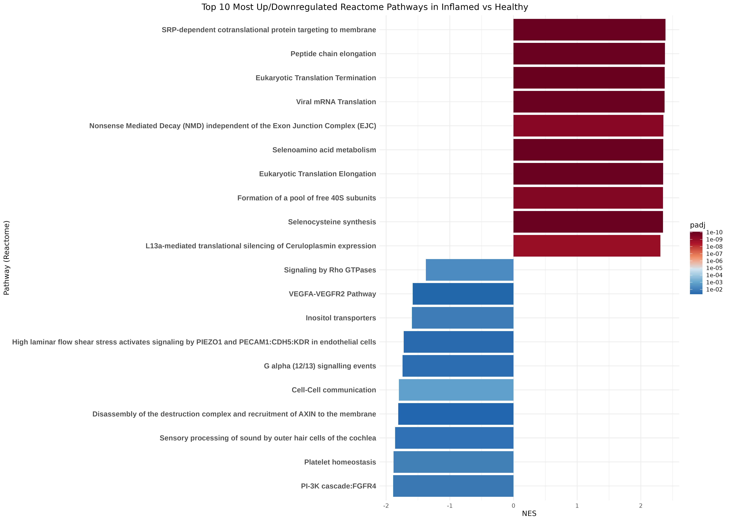
Gene Set Enrichment Analisys (GSEA)
GSEA shows an enhanced Immune system activity and a loss of endothelial barrier integrity
Group genes based on functionality (Based on annotated pathways used as background, in this case Reactome)
If the genes that are part of a pathway are enriched, the pathway will be enriched
FGSEA NES barplot. Top 10 Over/Under expressed pathways. Only pathways with padj < 0.05, ordered by NES

Slide 21
Gene Set Enrichment Analisys (GSEA)
GSEA shows an enhanced Immune system activity and a loss of endothelial barrier integrity
Upregulated Pathways show a general boosted metabolism, classical in inflamed cells
FGSEA NES barplot. Top 10 Over/Under expressed pathways. Only pathways with padj < 0.05, ordered by NES

Slide 22
Gene Set Enrichment Analisys (GSEA)
GSEA shows an enhanced Immune system activity and a loss of endothelial barrier integrity
Upregulated Pathways show a general boosted metabolism, classical in inflamed cells
Loss of endothelial barrier integrity (Downregulation of VEGFA pathway), consistent with overexpression of VCAM-1
FGSEA NES barplot. Top 10 Over/Under expressed pathways. Only pathways with padj < 0.05, ordered by NES

Slide 23
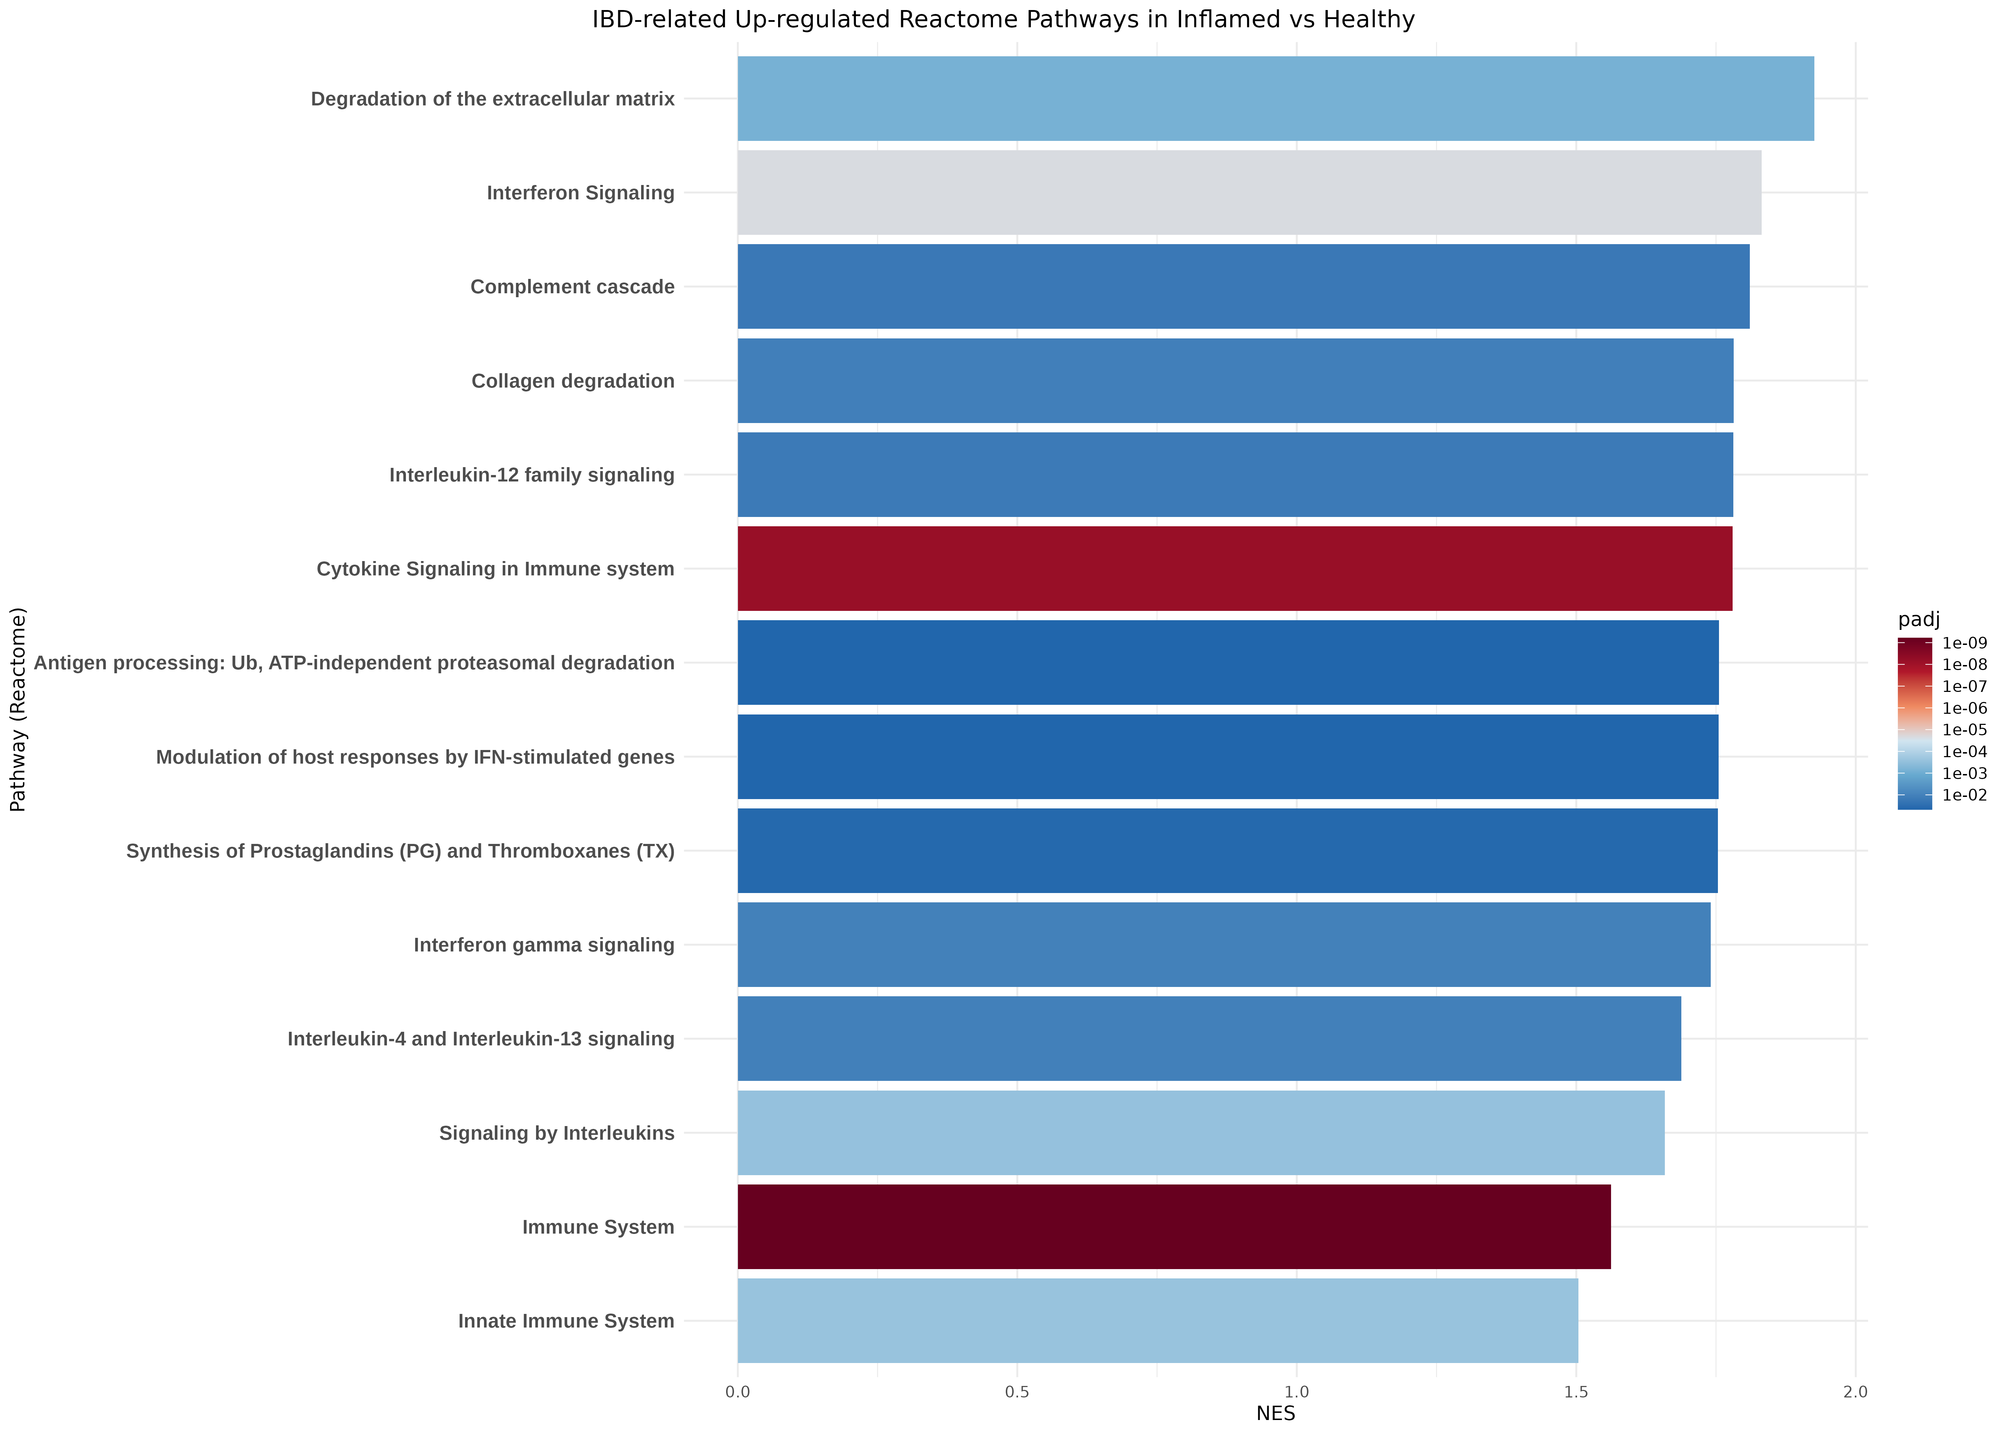
Gene Set Enrichment Analisys (GSEA)
GSEA shows an enhanced Immune system activity and a loss of endothelial barrier integrity
Metabolic pathways are hiding other important significantly upregulated pathways
Upregulated:
Immune System (Innate, Complement, Adaptative)
Pro-Inflammatory Signals (Interleukins, IFN-γ, Cytokines)
Extracellular matrix degradation
FGSEA NES barplot. IBD upregulated pathways. Only pathways with padj < 0.05, ordered by NES

Slide 24
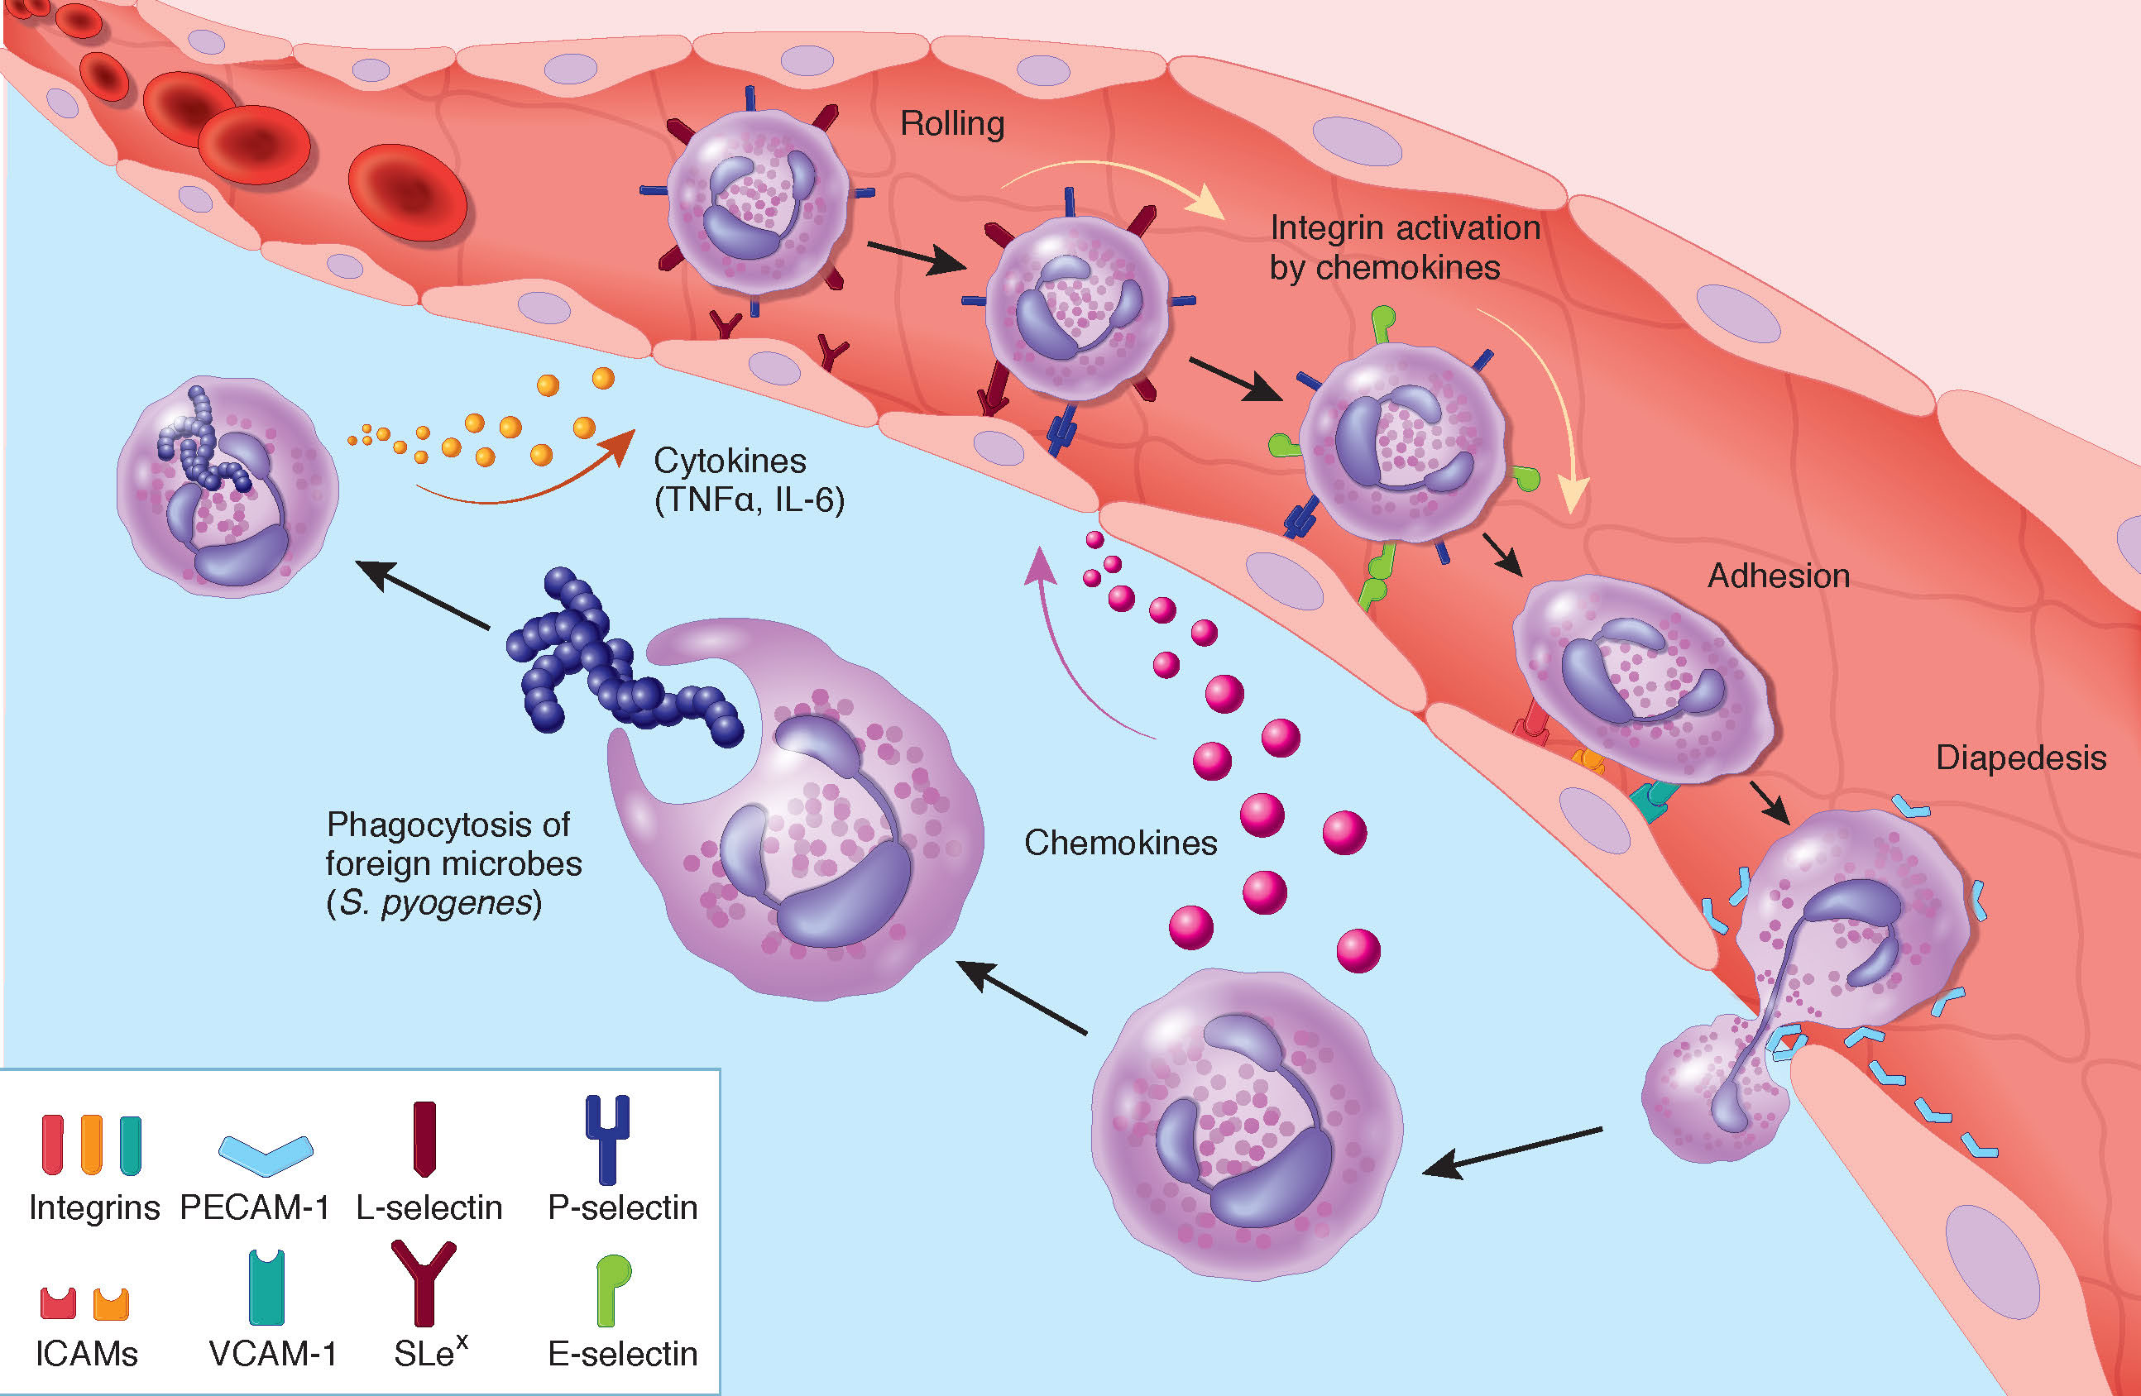
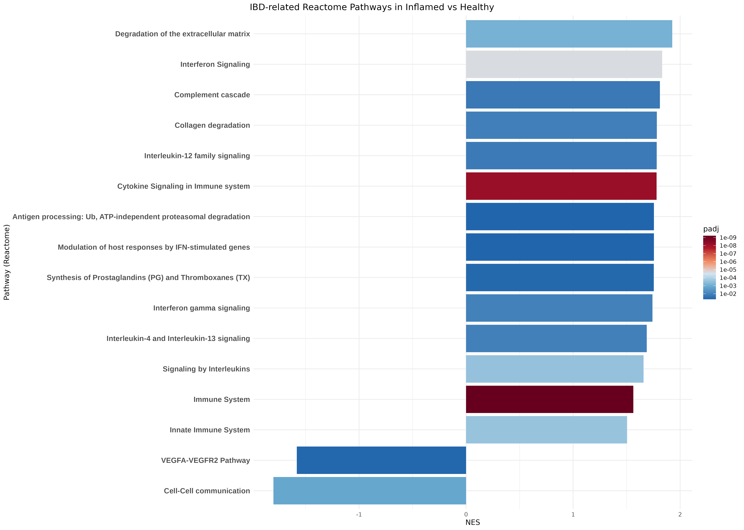
Gene Set Enrichment Analisys (GSEA)
GSEA shows an enhanced Immune system activity and a loss of endothelial barrier integrity
In Summary, in Inflamed samples we seem to have pericytes that:
Have an enhanced Immune System activity
Send and receive Pro Inflammatory signals
Dismantle blood endothelial barrier (Downregulation of VEGFA) and ECM.
Promote blood immune cell adhesion (Upregulation of ICAM-1)
Diapedesis process
FGSEA NES barplot. IBD related pathways. Only pathways with padj < 0.05, ordered by NES

Slide 25
Clustering, Pericytes Subtypes and DCATS
Clustering process
One of the objectives is to find different subpopulation of pericytes
FindNeighbors
FindClusters
UMAP
Choose Resolution
We are alrady working with only one cell type, be careful with overclusterizing

Slide 26
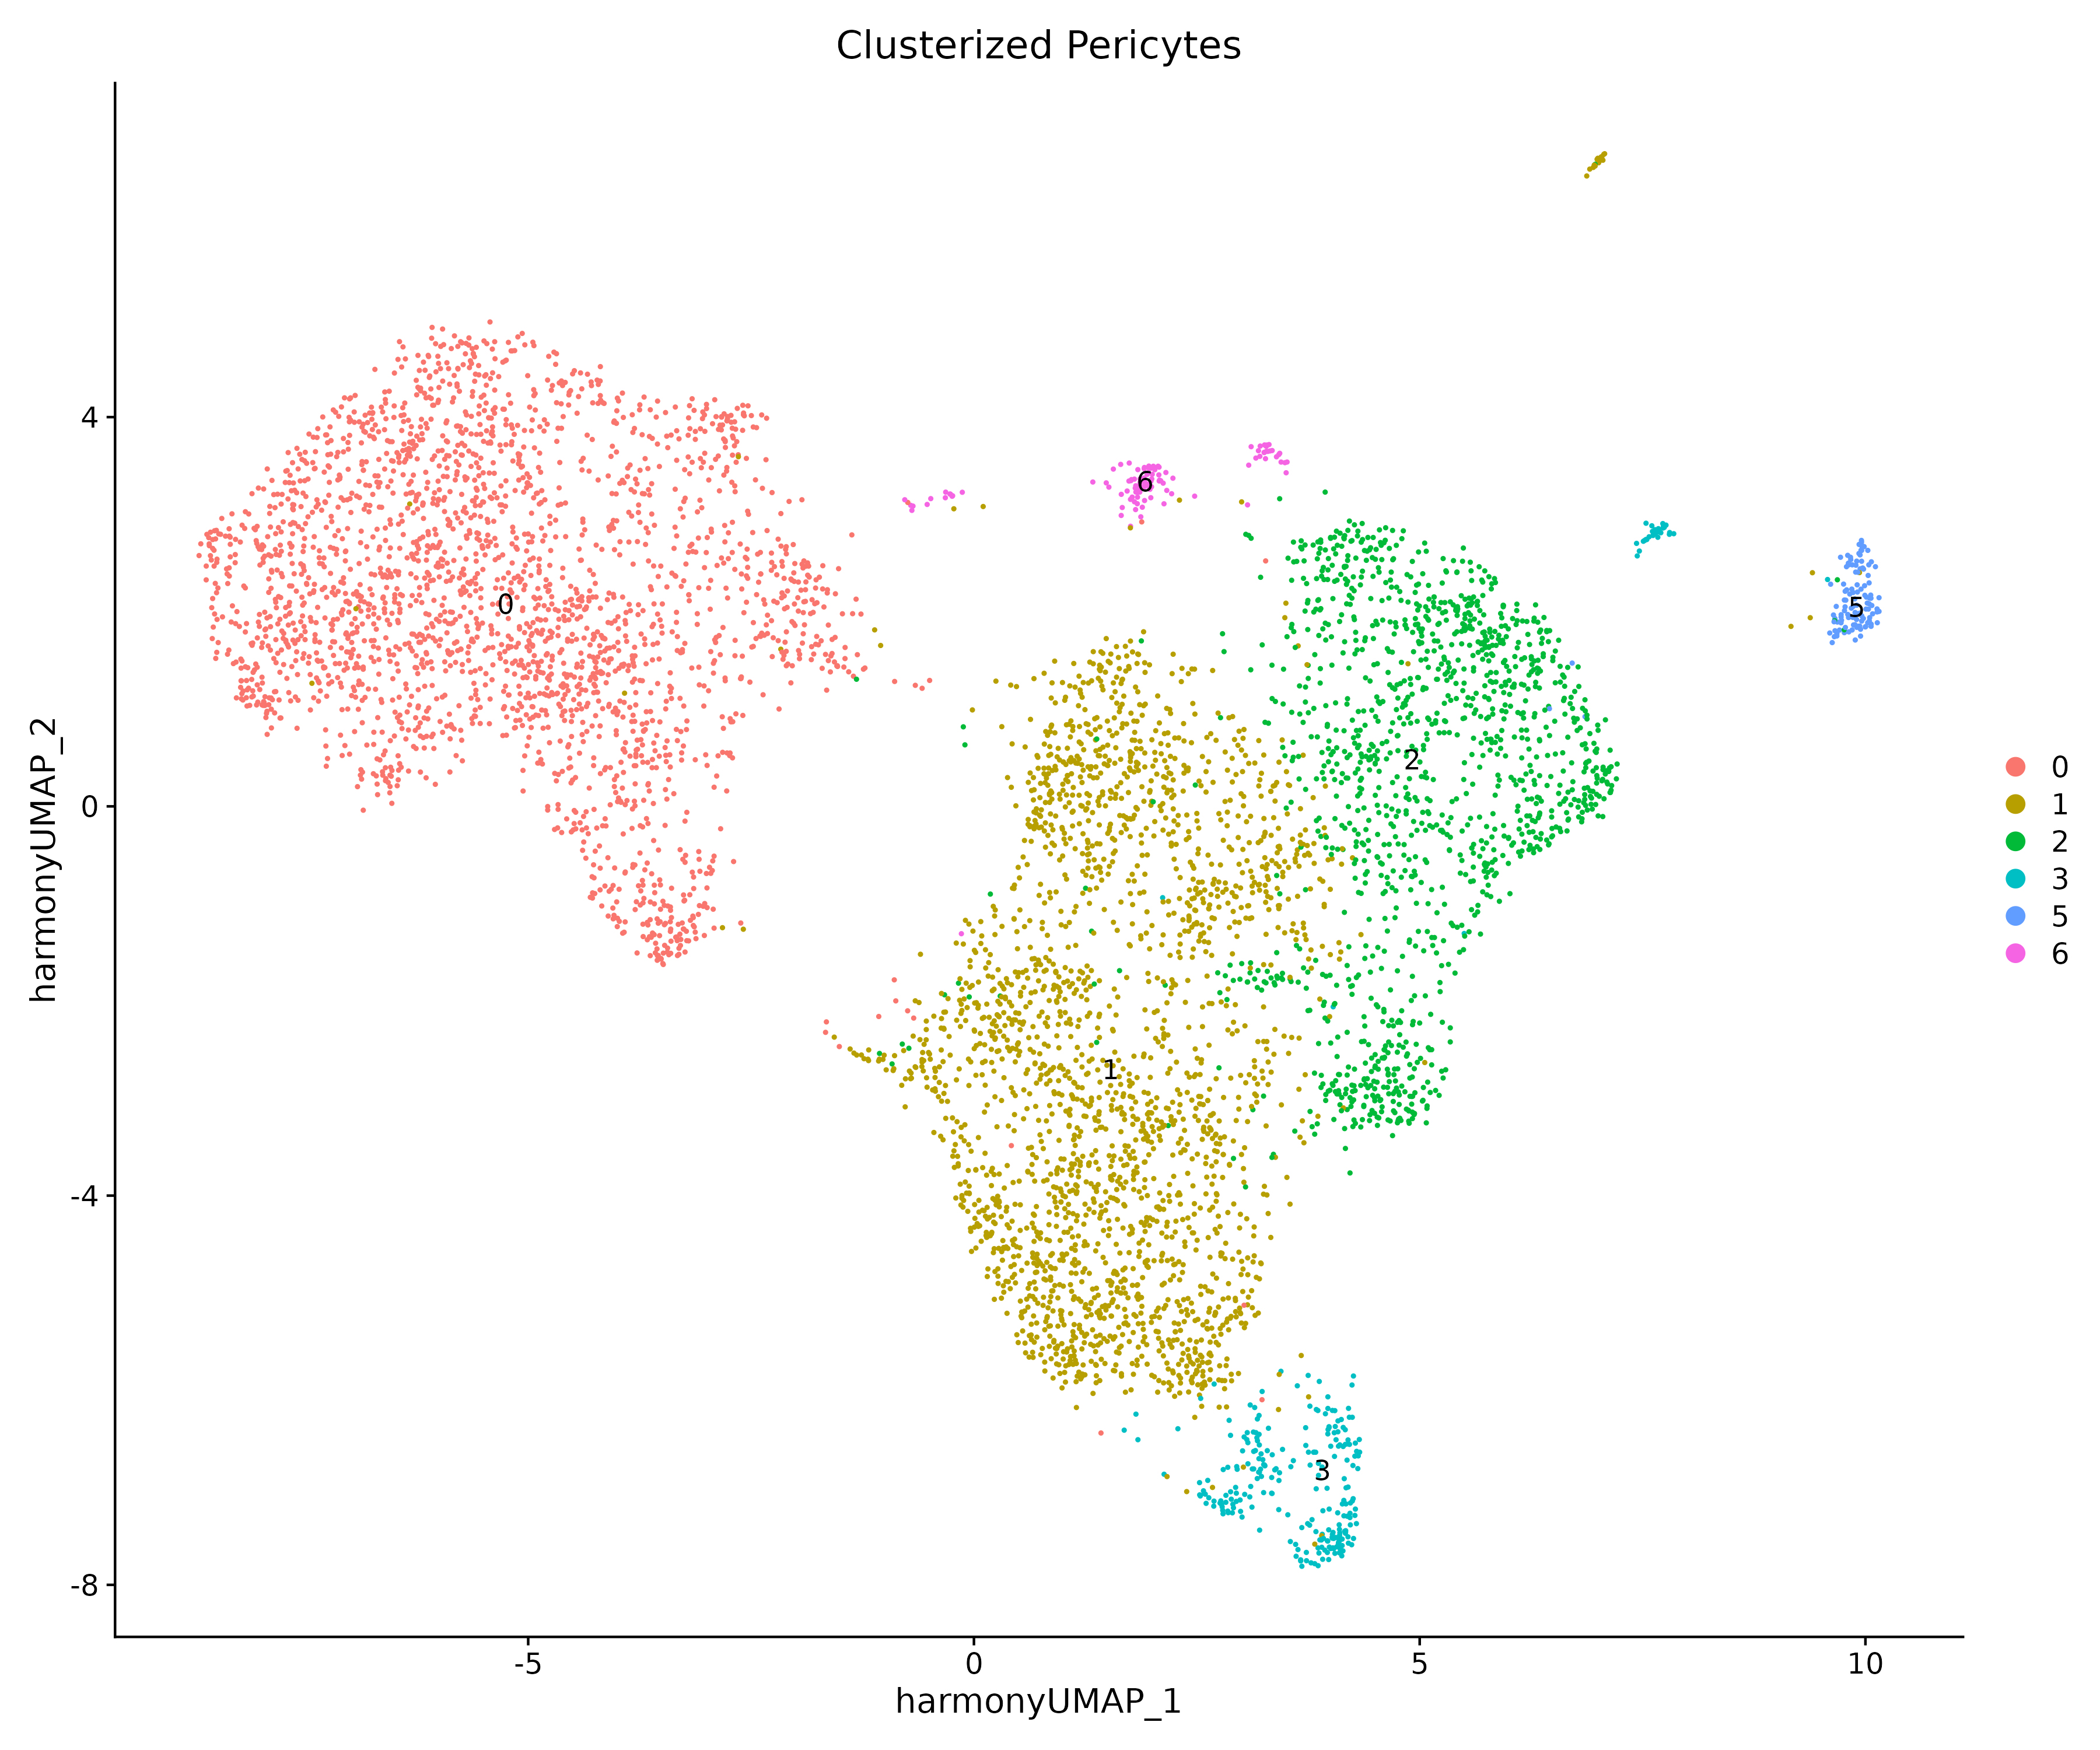
Clustering, Pericytes Subtypes and DCATS
Clustering process
One of the objectives is to find different subpopulation of pericytes
FindNeighbors
FindClusters
UMAP
Choose Resolution
We are already working with only one cell type, be careful with overclusterizing

Slide 27
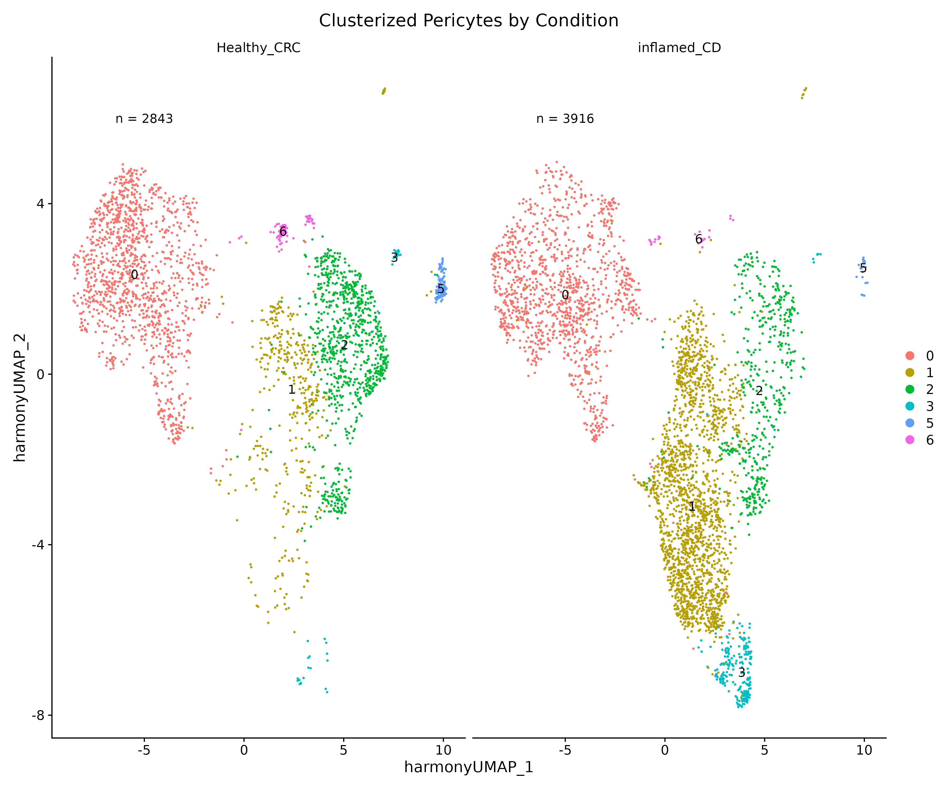
Clustering, Pericytes Subtypes and DCATS
Cluster 1 is significantly overexpressed in Inflamed samples, while clusters 2 and 5 are significantly underexpressed
The UMAP seem to show significantly differentially expressed clusers across conditons.
However, we shouldn’t trust the UMAP to confirm/dismiss this (human eye, dimensional reduction, different number of cells across conditions
UMAP plot grouped by Cluster and Splitted by Condition

Slide 28
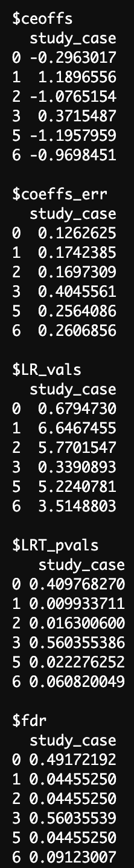
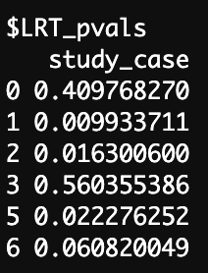
Clustering, Pericytes Subtypes and DCATS
Cluster 1 is significantly overexpressed in Inflamed samples, while clusters 2 and 5 are significantly underexpressed
To confirm that a cluster is significantly over/under expressed across conditions, we use DCATS
DCATS takes into account the total number of cells per condition, total number of cell per cluster… And provides a pvalue/fdr per cluster.
UMAP plot grouped by Cluster and Splitted by Condition

Slide 29
Clustering, Pericytes Subtypes and DCATS
Cluster 1 is significantly overexpressed in Inflamed samples, while clusters 2 and 5 are significantly underexpressed
To confirm that a cluster is significantly over/under expressed across conditions, we use DCATS
DCATS takes into account the total number of cells per condition, total number of cell per cluster… And provides a pvalue/fdr per cluster.
UMAP plot grouped by Cluster and Splitted by Condition

Slide 30
Clustering, Pericytes Subtypes and DCATS
Cluster 1 is significantly overexpressed in Inflamed samples, while clusters 2 and 5 are significantly underexpressed
To confirm that a cluster is significantly over/under expressed across conditions, we use DCATS
DCATS takes into account the total number of cells per condition, total number of cell per cluster… And provides a pvalue/fdr per cluster.
UMAP plot grouped by Cluster and Splitted by Condition

Slide 31
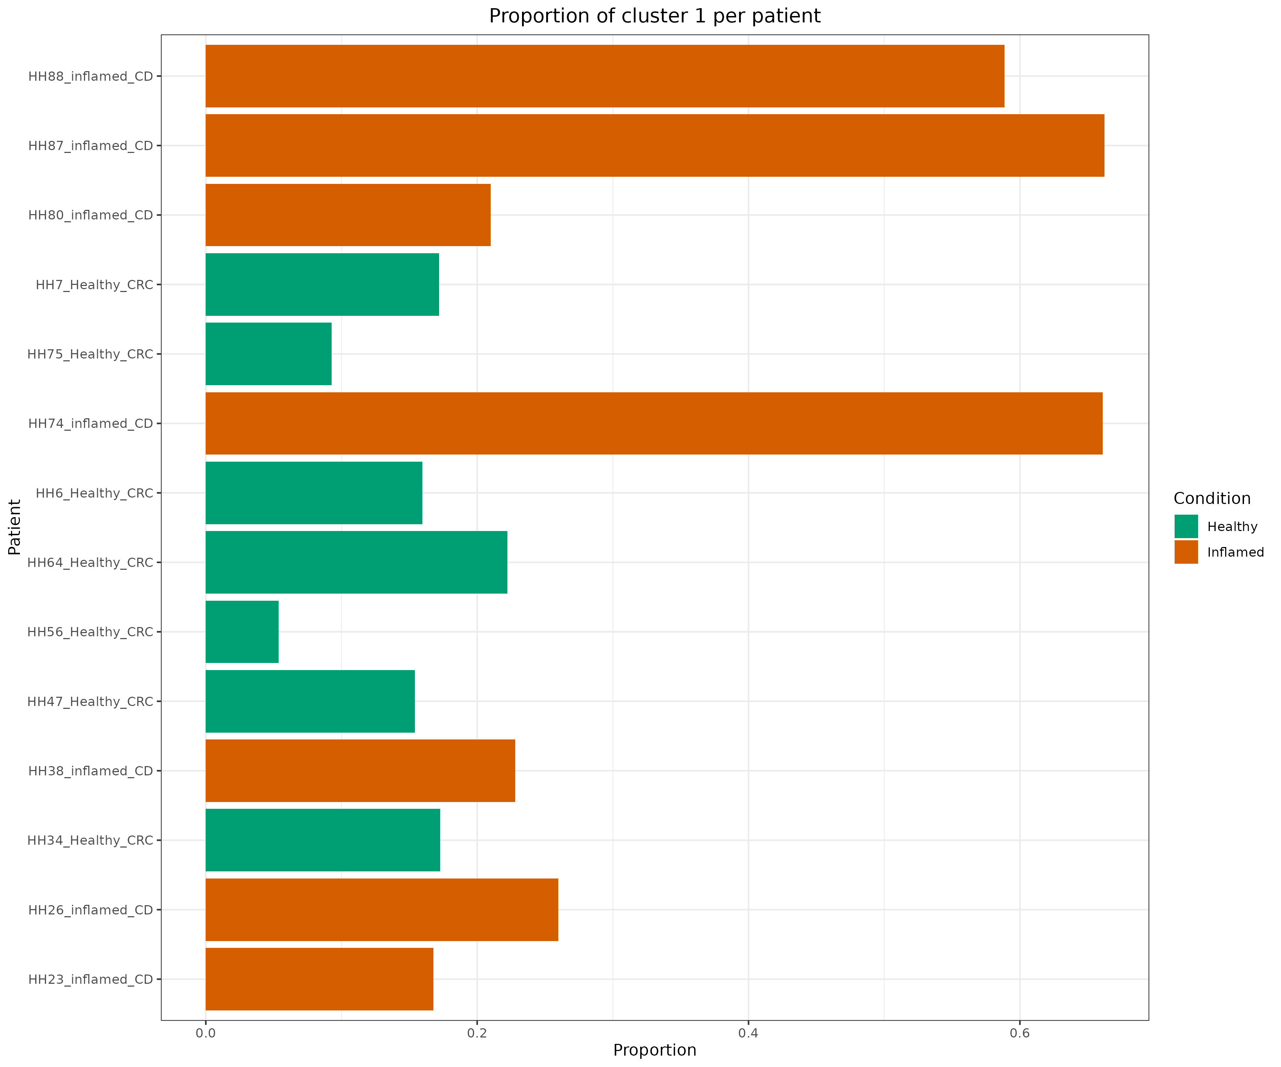
Clustering, Pericytes Subtypes and DCATS
Cluster 1 is highly populated in patients that showed a “High Inflammation” profile

Slide 32
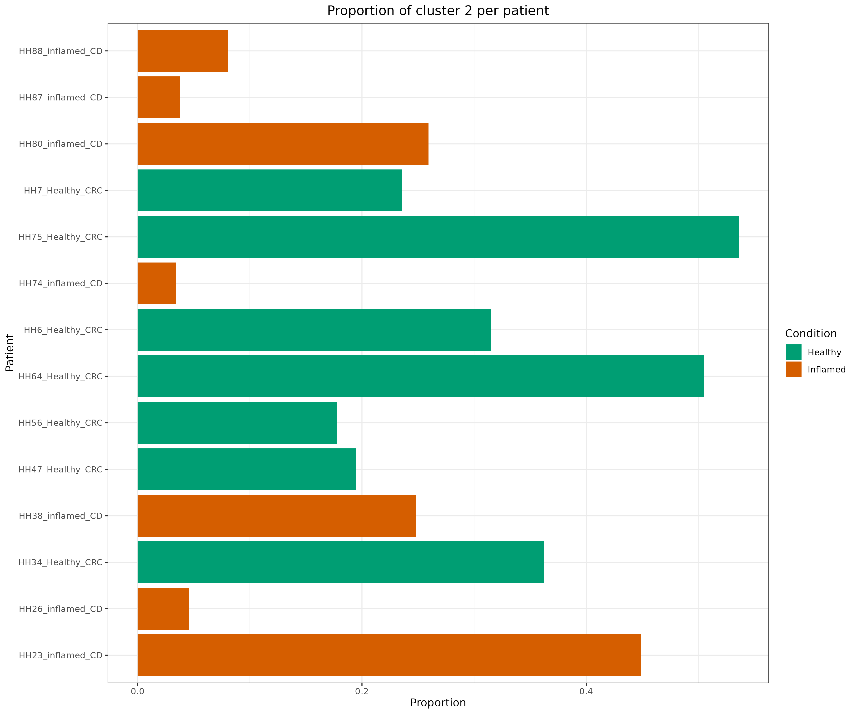
Clustering, Pericytes Subtypes and DCATS
Cluster 1 is highly populated in patients that showed a “High Inflammation” profile

Slide 33
Clustering, Pericytes Subtypes and DCATS
Cluster 1 is highly populated in patients that showed a “High Inflammation” profile
Patients HH74, HH87 and HH88 clearly show a higher proportion of cluster 1 pericytes, standing out even from the rest of the inflamed samples
We already saw this patients group together in the DEG analysis.

Slide 34
Clustering, Pericytes Subtypes and DCATS
Cluster 1 and 3 pericytes (Overexpressed in Inflamed) show a clear Pro-Inflammatory cell state
1. Choose a functionally related set of genes
As we have spotted the different cluster populations across Conditions/Patients, it would be interesting to see the functional profile of each cluster
2. Compute per cell score using “AddModuleScore( )”
3. Group cells by cluster and compute average score per cluster

Slide 35
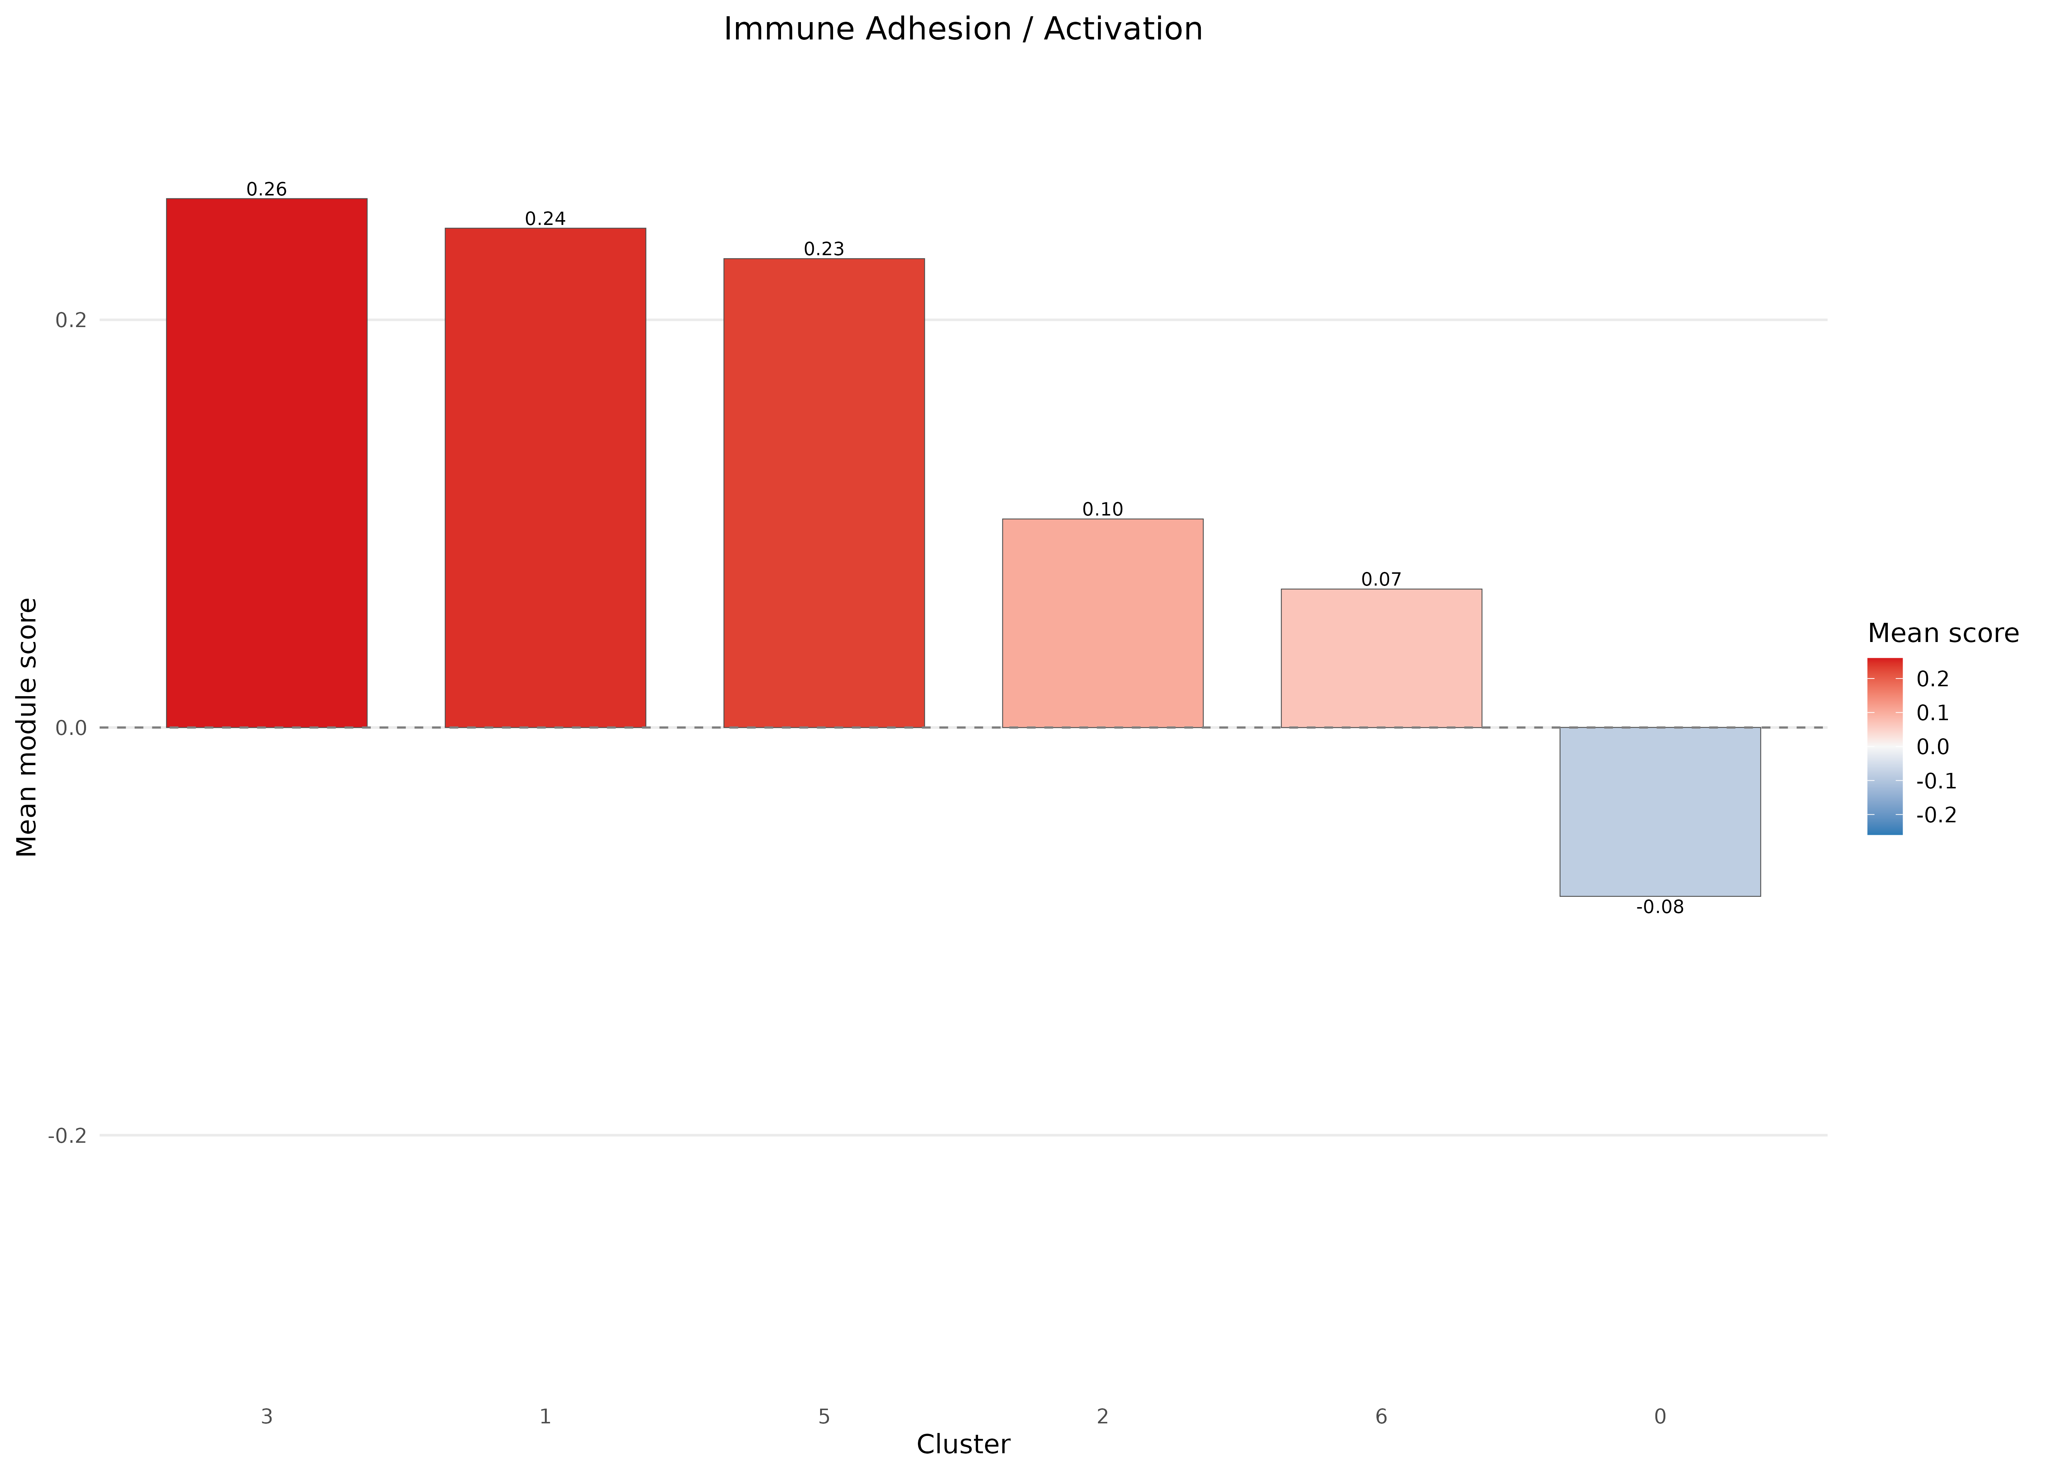
Clustering, Pericytes Subtypes and DCATS
Cluster Functional Profiles
Immune Cells activation and Adhesion:
c(“VCAM1”, “ICAM1”, “SELE”, “SELPLG”, “PECAM1”, ”CD44”, “SERPING1”)
Accounts for genes related to diapedesis, Immune celll adhesion and activation.
Cluster 1, 3 and 5 exhibit the highest scores

Slide 36
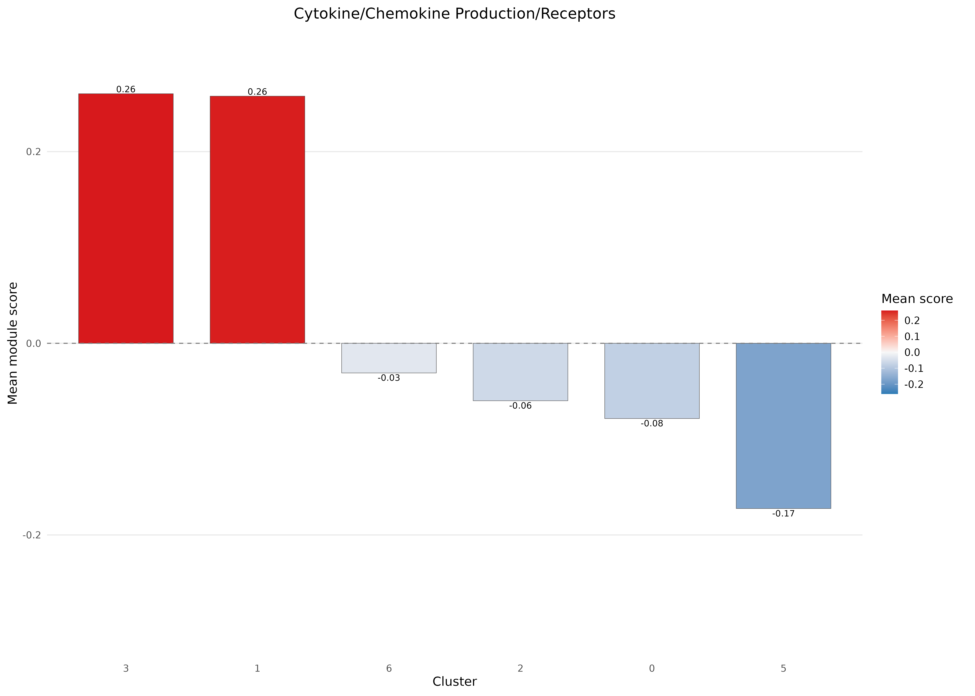
Clustering, Pericytes Subtypes and DCATS
Cluster Functional Profiles
Cytokines Activation
c("CCL2", "CCL5", "CXCL1", "CXCL1", "CXCL8", "IL6", "TNF", "IL33", "CCL19", "CCL21", "MIF", "TNFRSF25", "TNFSF15", "IL11", "IL6R", "IL1R2", "IL1R1", "OSMR", "IL7”)
Accounts for genes related pro inflammatory signaling and cytokine/chemokine networks
Cluster 1 and 3 exhibit the highest scores

Slide 37
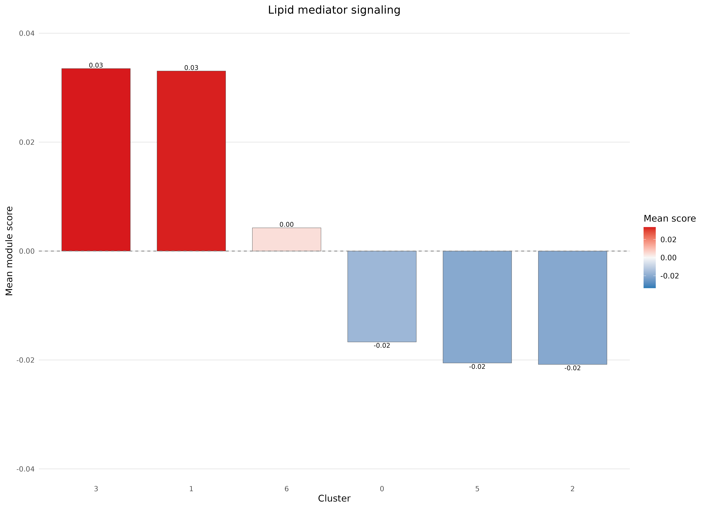
Clustering, Pericytes Subtypes and DCATS
Cluster Functional Profiles
Lipid Pro-Inflammatory Signalign
c("PLA2G4A","PLA2G2A","PLA2G5","PLA2G10","PLA2G6” , "PTGS1", "PTGS2", "PTGER1", "PTGER2", "PTGER3", "PTGER4", "ALOX5", "ALOX12", "ALOX15”)
Bioactive lipids like prostraglandines and PLAs that drive inflammation responses
Cluster 1 and 3 exhibit the highest scores

Slide 38
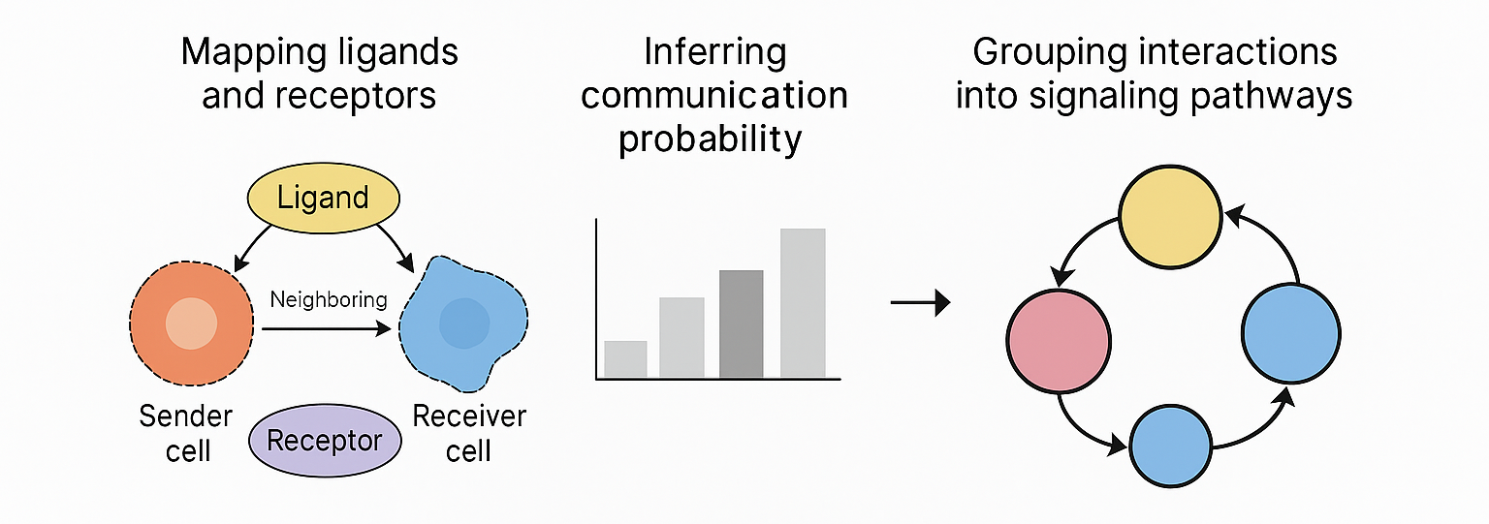
Cell to Cell Communication Network
Introduction
As pericytes are not classical effector cells in the context of IBD. Instead, one of their main roles is acting as communicators.
Therefore, we will study how pericytes communicate to their surrounding cells in Inflammed and Healthy Patients using CellChat.
How does CellChat work?

Slide 39
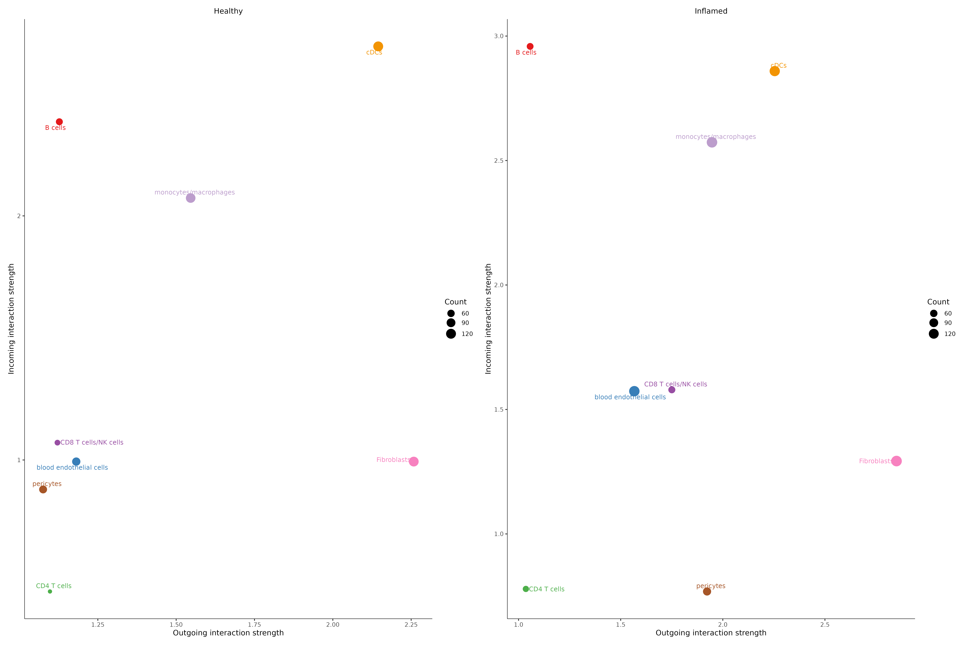
Cell to Cell Communication Network
Inflamed Patients Pericytes exhibit an increase in Outgoing interactions compared to Healthy
Compare all celltypes incoming and outgoing interactions in Healthy Vs Inflamed
Pericytes show a minor decrease in incoming interactions and a Major increase in outgoing interactions
Efector Celltypes like B cells or Monocytes show an increase in incoming interactions
Healthy Vs Inflamed Per Cell type incoming (Y axis) and outgoing (X axis) interactions

Slide 40
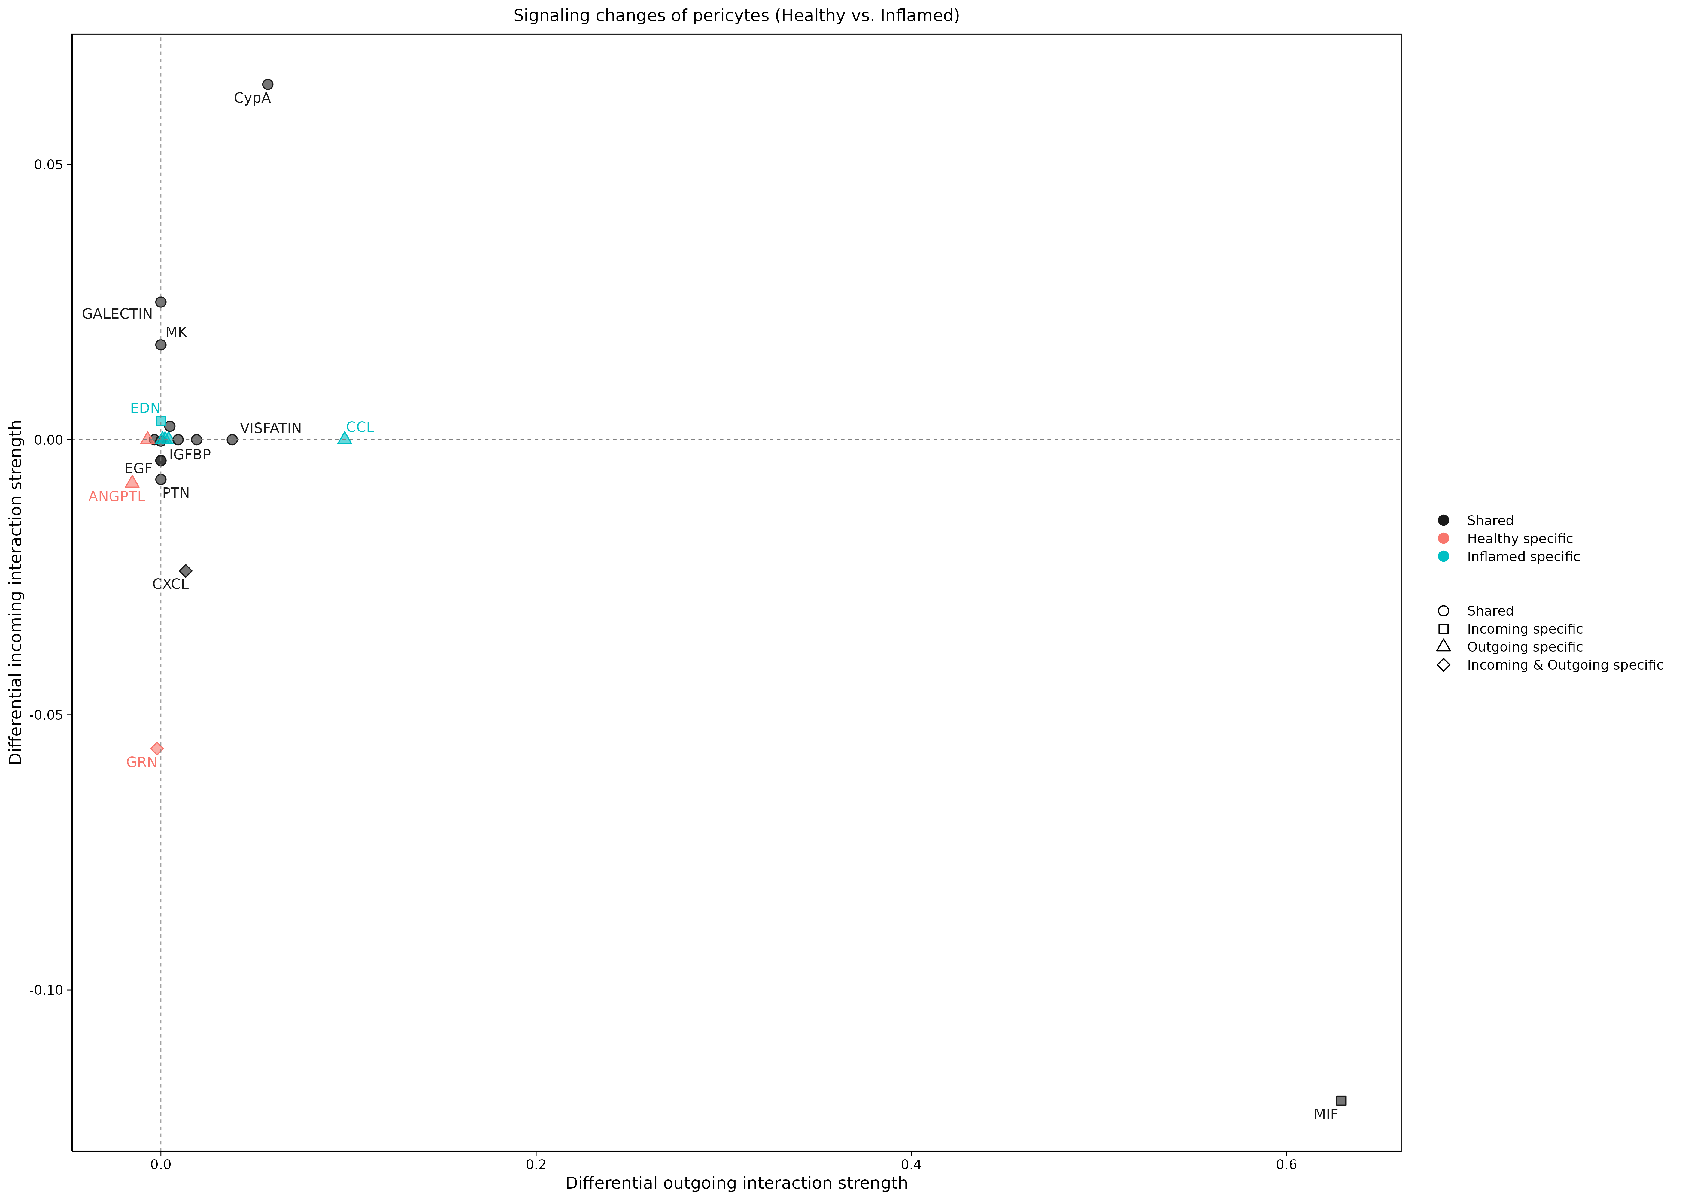
Cell to Cell Communication Network
Inflamed Pericytes send more pro Inflammatory signals like MIF, CCL and CXCL
In inflamed samples, pericytes show increased signaling through pro-inflammatory pathways such as MIF, CCL, and CXCL compared to healthy samples.
“Macrophage migration inhibitory factor (MIF) is a glycosylated multi-functional protein that acts as an enzyme as well as a cytokine. MIF mediates its actions through a cell surface class II major histocompatibility chaperone, CD74 and co-receptors such as CD44, CXCR2, CXCR4 or CXCR7. MIF has been implicated in the pathogenesis of several acute and chronic inflammatory diseases”. [Subbannayya et al. (2016]

Slide 41
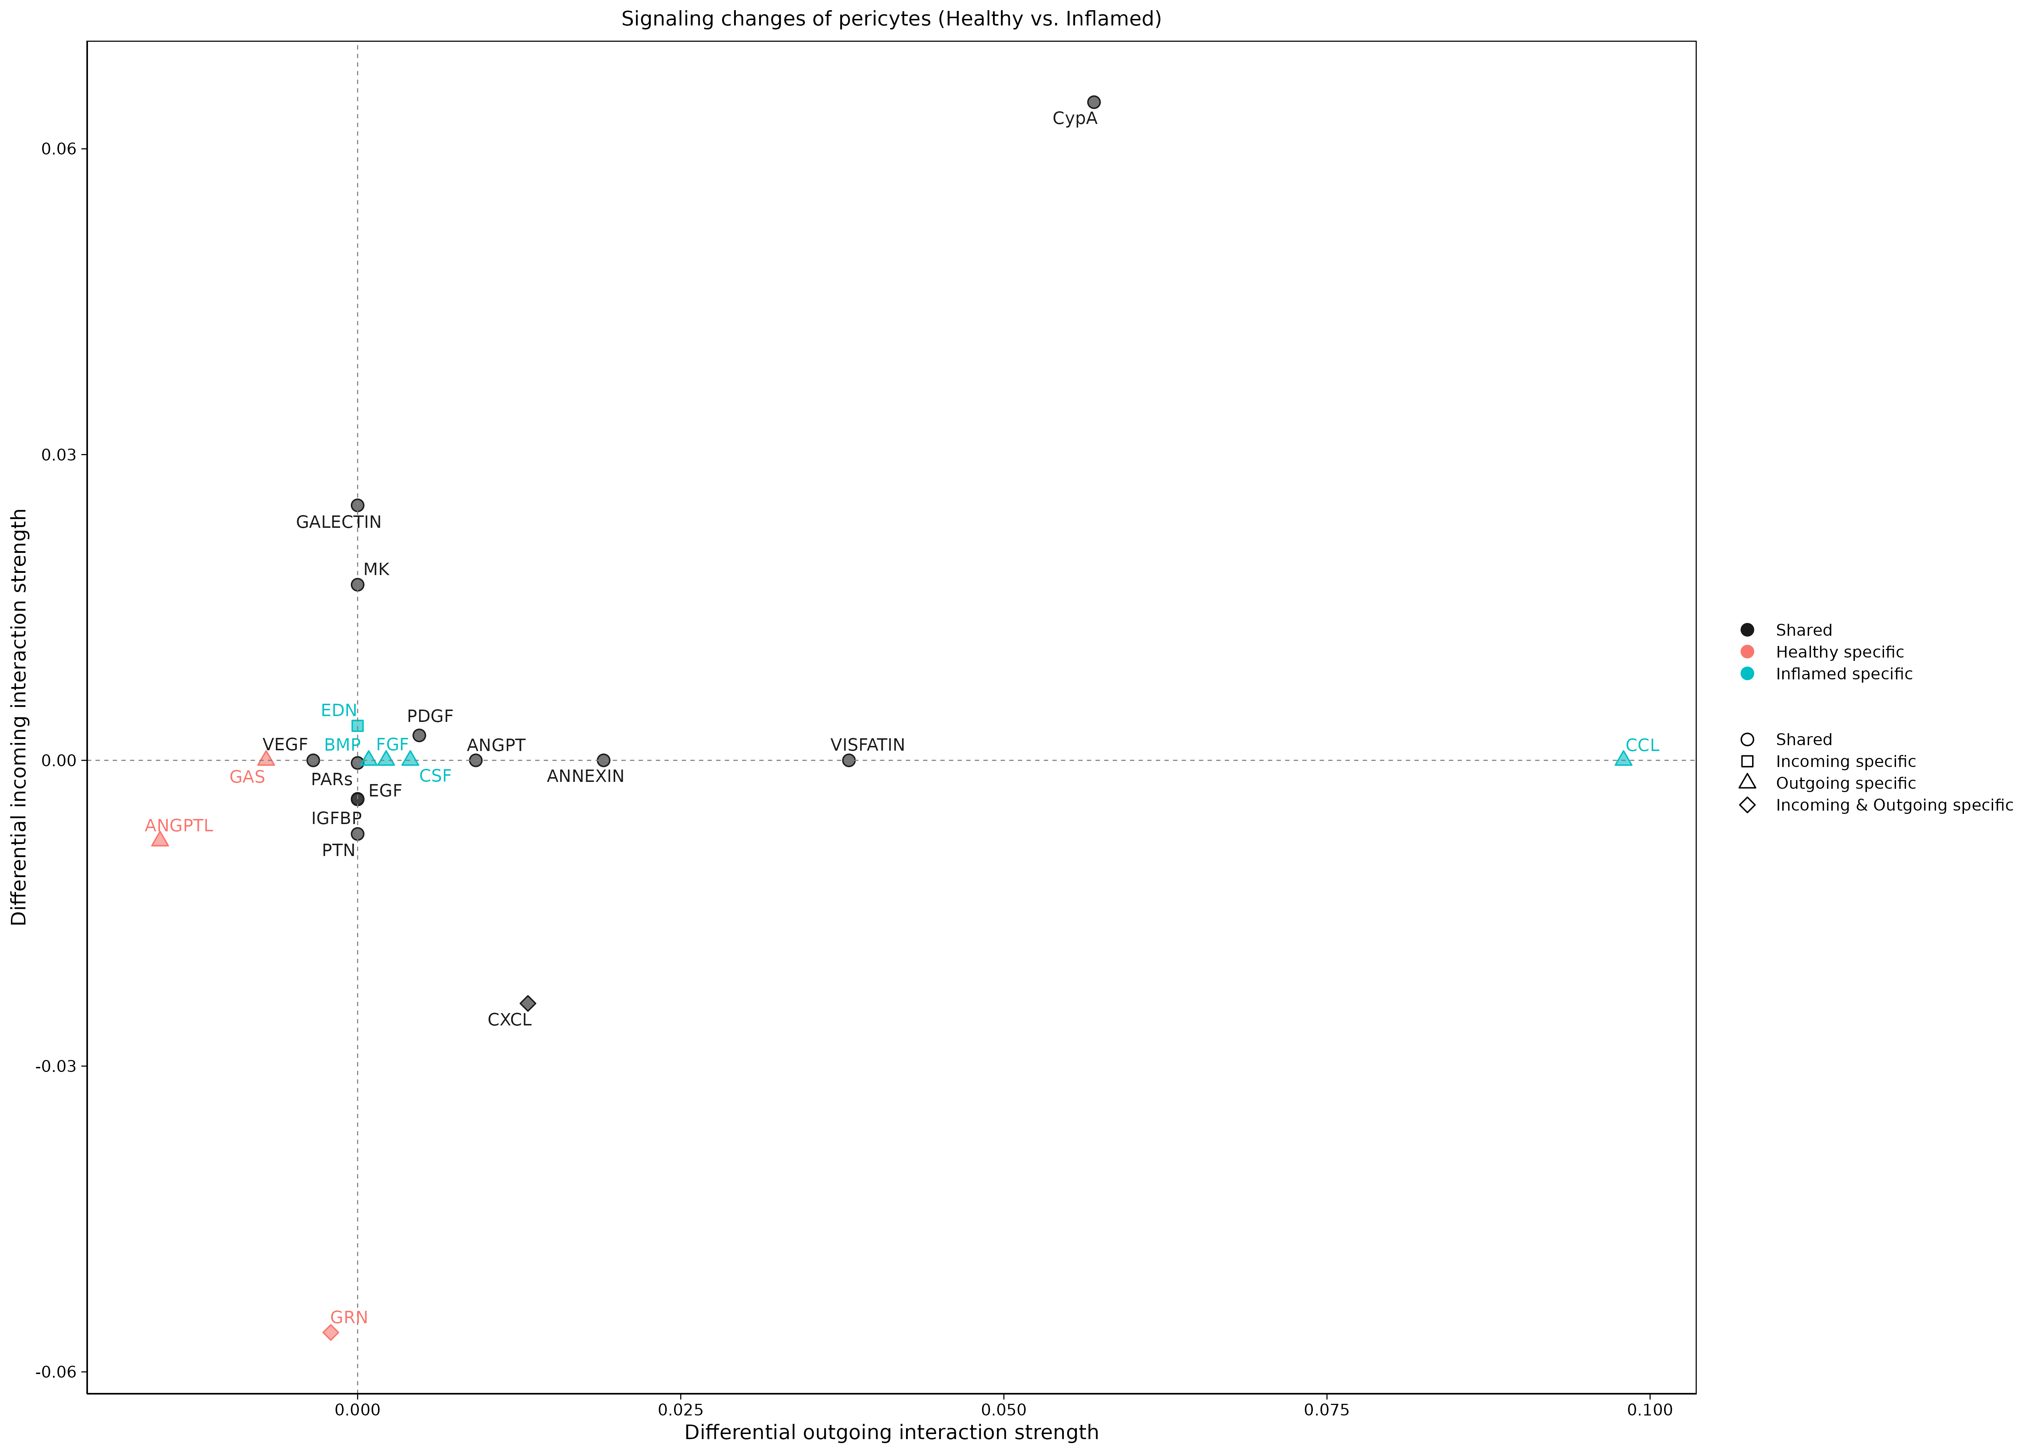
Cell to Cell Communication Network
Inflamed Pericytes send more pro Inflammatory signals like MIF, CCL and CXCL
In inflamed samples, pericytes show increased signaling through pro-inflammatory pathways such as MIF, CCL, and CXCL compared to healthy samples.
“Macrophage migration inhibitory factor (MIF) is a glycosylated multi-functional protein that acts as an enzyme as well as a cytokine. MIF mediates its actions through a cell surface class II major histocompatibility chaperone, CD74 and co-receptors such as CD44, CXCR2, CXCR4 or CXCR7. MIF has been implicated in the pathogenesis of several acute and chronic inflammatory diseases”. [Subbannayya et al. (2016]

Slide 42
Conclusions
Biological Conclusions
1. Inflammation is a very heterogenous and intrincated process, that can show different degrees and underliying pathways, it is important to analyze each patient individually
Secretion of pro-inflammatory mediators and Pathways (e.g., IL, MIF, CCL)
2. Pericytes contribute to inflammation mainly in two ways
Facilitating diapedesis by weakening the blood endothelial barrier (e.g., VEGFA) and emiting adhesion molecules (e.g., VCAM-1)
3. Clusters representing pericytes in a homeostatic state are reduced in inflamed samples, while clusters enriched for pro-inflammatory pericytes expand.

Slide 43
Conclusions
Single Cell Conclusions
What have I learnt during the course?
1. Invest time in knowing your data and experimental design. Each dataset it’s different, try to maximize it’s strengths and minimize it’s weaknesess
2. There is not always a ”correct” or “incorrect” approach, but you should always be aware of what are you doing and why
3. Batch effects will always be there, so you have to learn how to live and deal with them. Even if you use integration/correction methods you should always be sceptic with your results
4. Single Cell data gives you a lot of information (Sometimes too much!!). It is good to do some exploratory analysis, but always having in mind the focus of you analysis and what questions you want to answer

Slide 44
References
Subbannayya T, Variar P, Advani J, et al. An integrated signal transduction network of macrophage migration inhibitory factor. J Cell Commun Signal. 2016;10(2):165-170. doi:10.1007/s12079-016-0326-x
Korsunsky, I., Millard, N., Fan, J. et al. Fast, sensitive and accurate integration of single-cell data with Harmony. Nat Methods 16, 1289–1296 (2019). https://doi.org/10.1038/s41592-019-0619-0
van Splunder H, Villacampa P, Martínez-Romero A, Graupera M. Pericytes in the disease spotlight. Trends Cell Biol. 2024 Jan;34(1):58-71. doi: 10.1016/j.tcb.2023.06.001. Epub 2023 Jul 18. PMID: 37474376; PMCID: PMC10777571
Hanbin Lee, Buhm Han, Pseudobulk with proper offsets has the same statistical properties as generalized linear mixed models in single-cell case-control studies, Bioinformatics, Volume 40, Issue 8, August 2024, btae498, https://doi.org/10.1093/bioinformatics/btae498
Gaber, T., Strehl, C. & Buttgereit, F. Metabolic regulation of inflammation. Nat Rev Rheumatol 13, 267–279 (2017). https://doi.org/10.1038/nrrheum.2017.37
Neurath, M. Cytokines in inflammatory bowel disease. Nat Rev Immunol 14, 329–342 (2014). https://doi.org/10.1038/nri3661
https://htmlpreview.github.io/?https://github.com/jinworks/CellChat/blob/master/tutorial/CellChat-vignette.html

Slide 45
THANK YOU!!

Slide 46
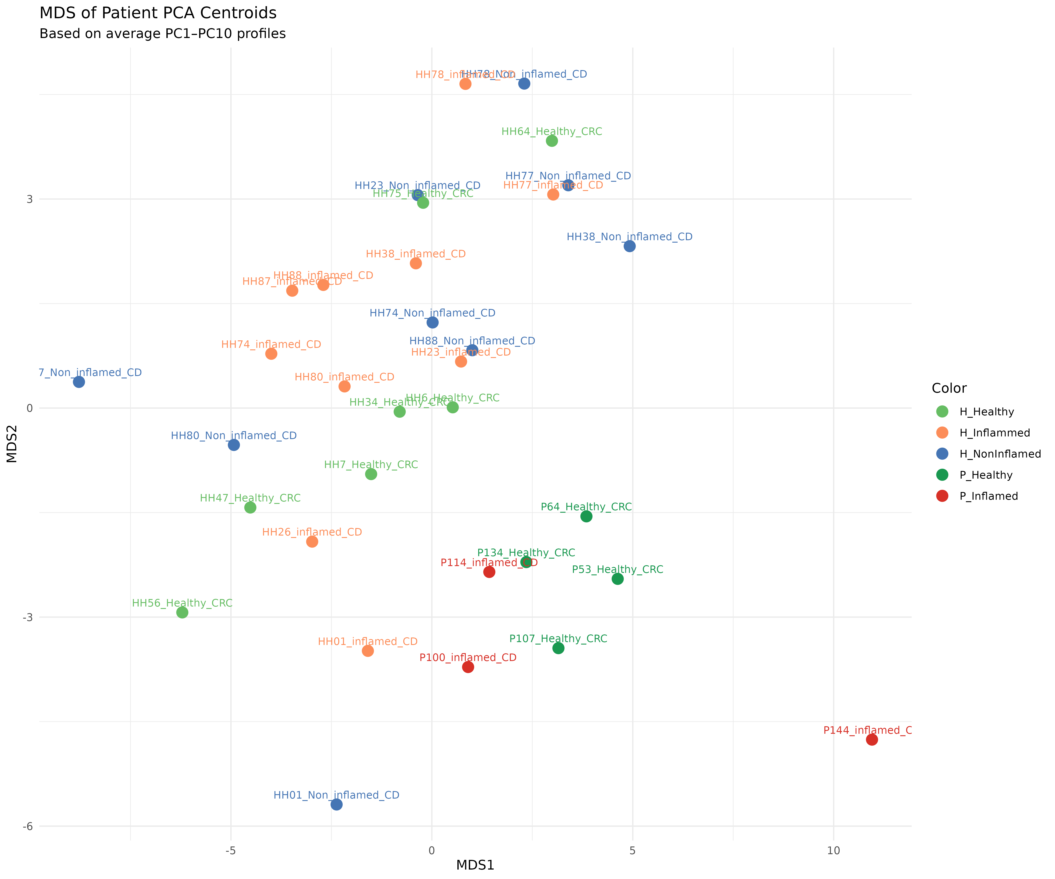
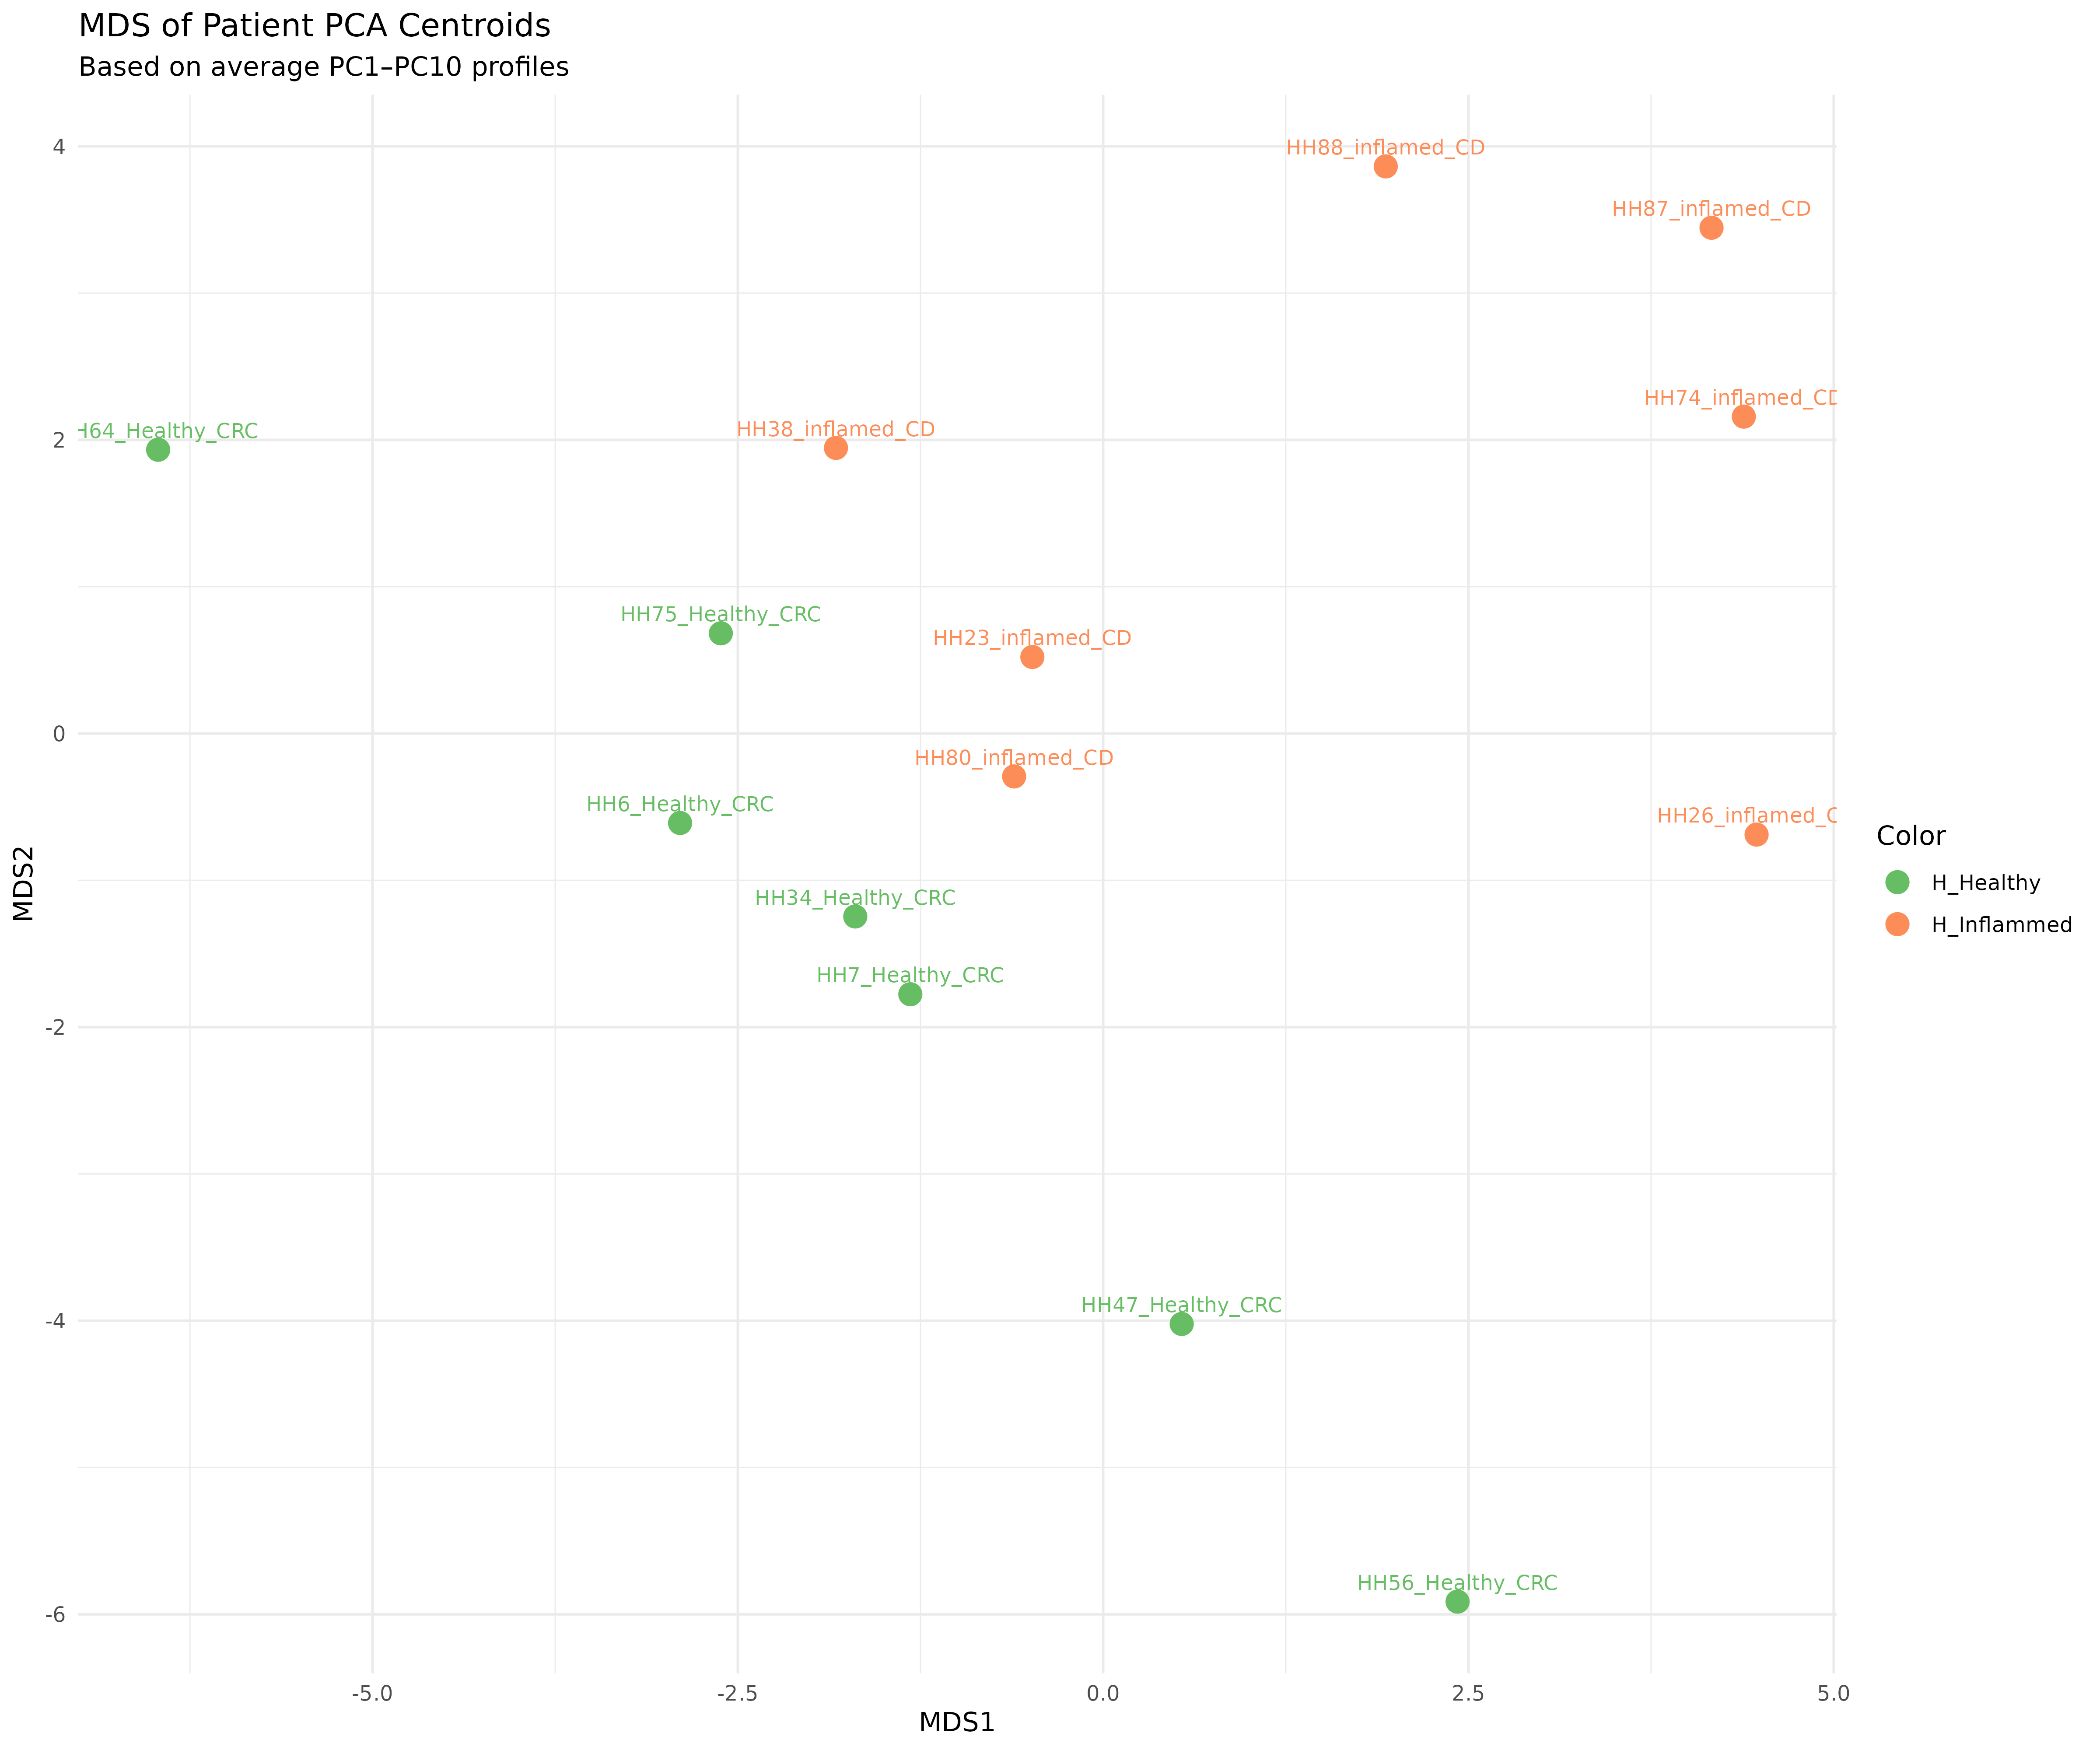
Study conditions and Patient Selection
Starting with 44 Samples (32 different patients):
15 Inflamed
11 Non Inflamed
18 Healthy
Objective: Identify and exclude patients whose gene expression profiles exhibit outlier or patient-specific effects, as these may confound downstream biological interpretations.
MDS plot to see the global gene expression profile of each patient. (Average PC1 – PC10, 63% variance explained)

Slide 47
Study conditions and Patient Selection
Filtered out:
Patients with < 40 cells

Slide 48
Study conditions and Patient Selection
Filtered out:
“P” patients get grouped together

Slide 49
Study conditions and Patient Selection
Filtered out:
“P” patients get grouped together
Patients HH78 and HH77 seem to group according to the patient than to the condition

Slide 50
Study conditions and Patient Selection
Filtered out:
“P” patients get grouped together
Patients HH78 and HH77 seem to group according to the patient than to the condition
Patient HH01 group according to patient and shows a unique expression

Slide 51
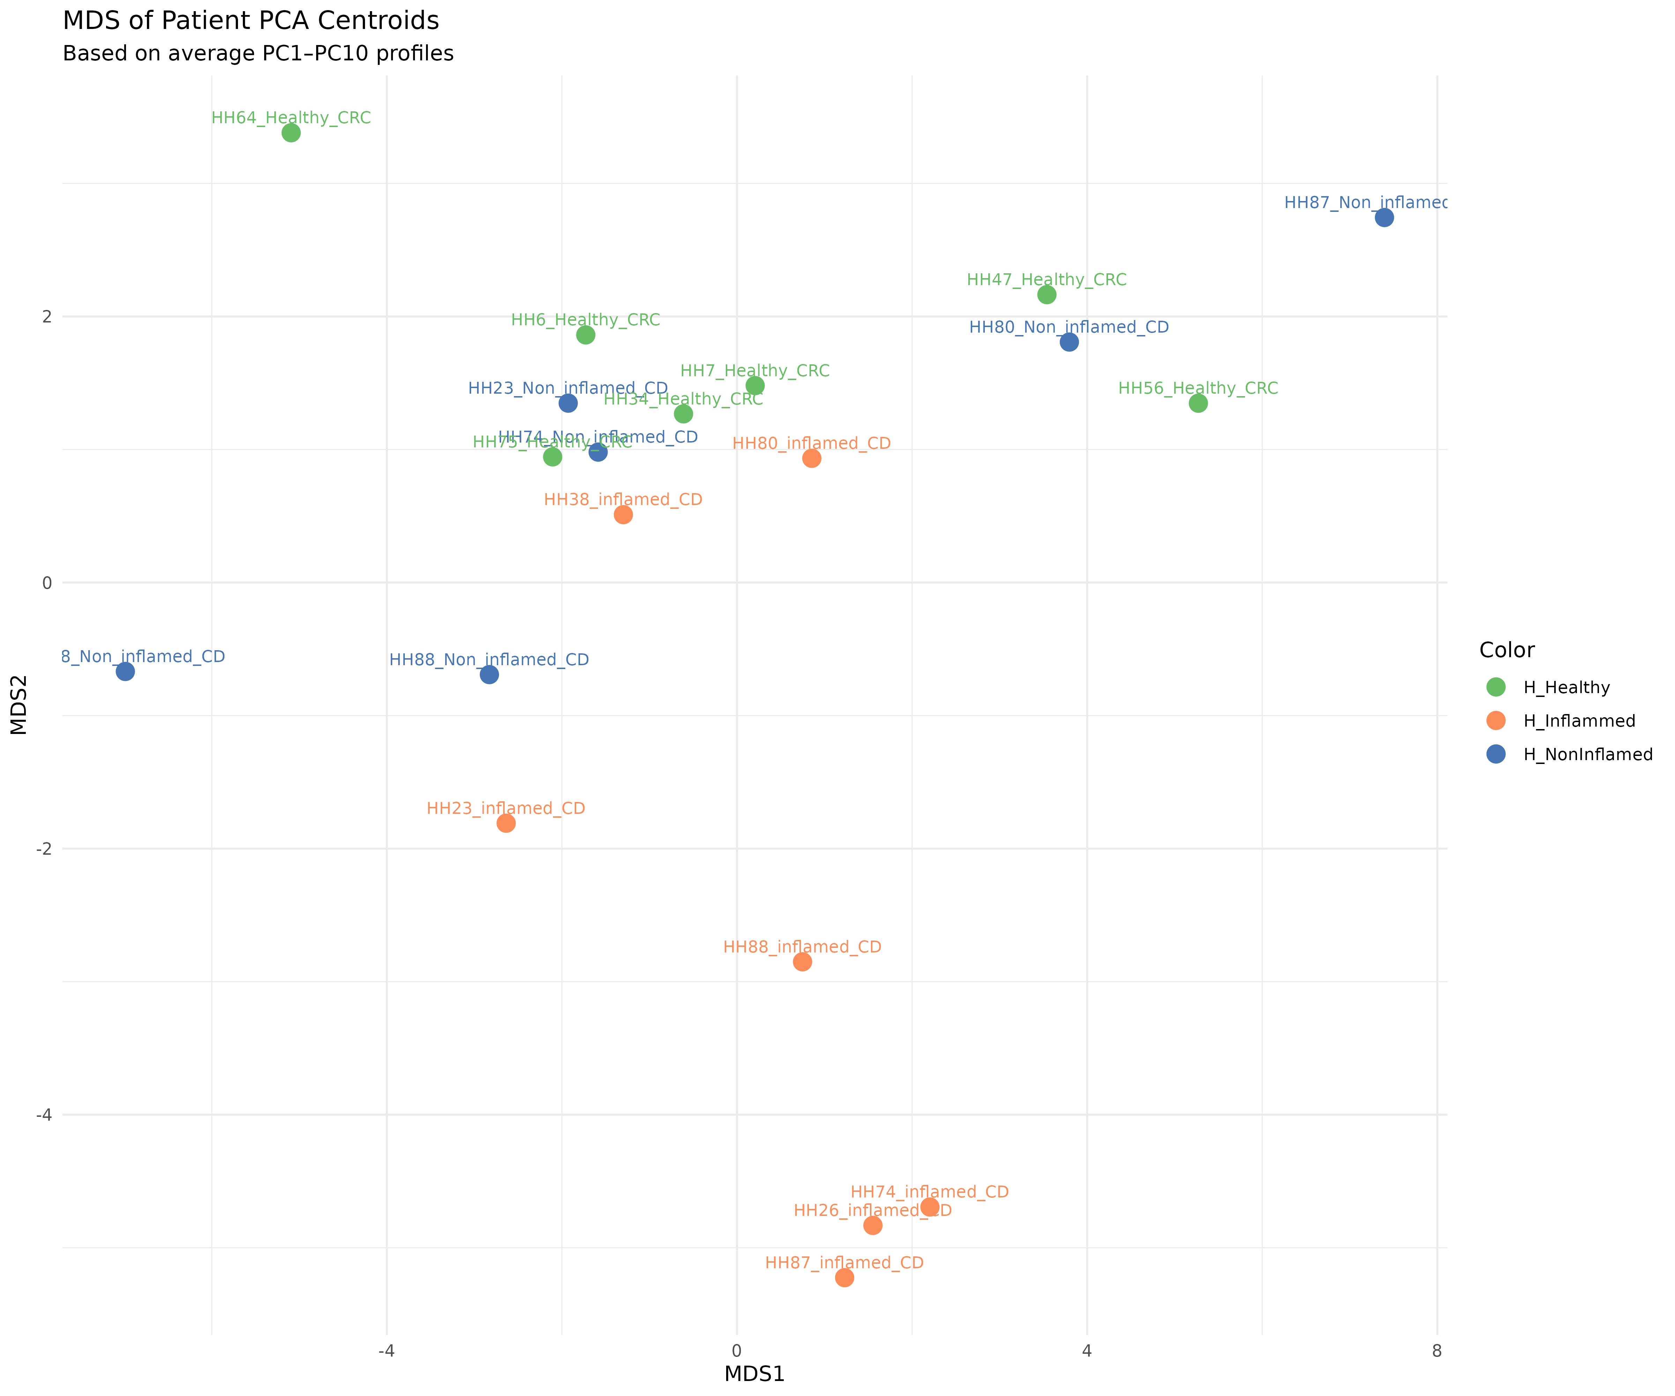
Study conditions and Patient Selection
Non Inflamed samples:
Low number of cells
Do not form a uniform cluster at MDS
Low number of DEGs

Slide 52
Study conditions and Patient Selection
Final Selection:
7 Inflamed Patients
7 Healthy Patients
Not clear clusters per condition, important to check gene expression individually

Slide 53
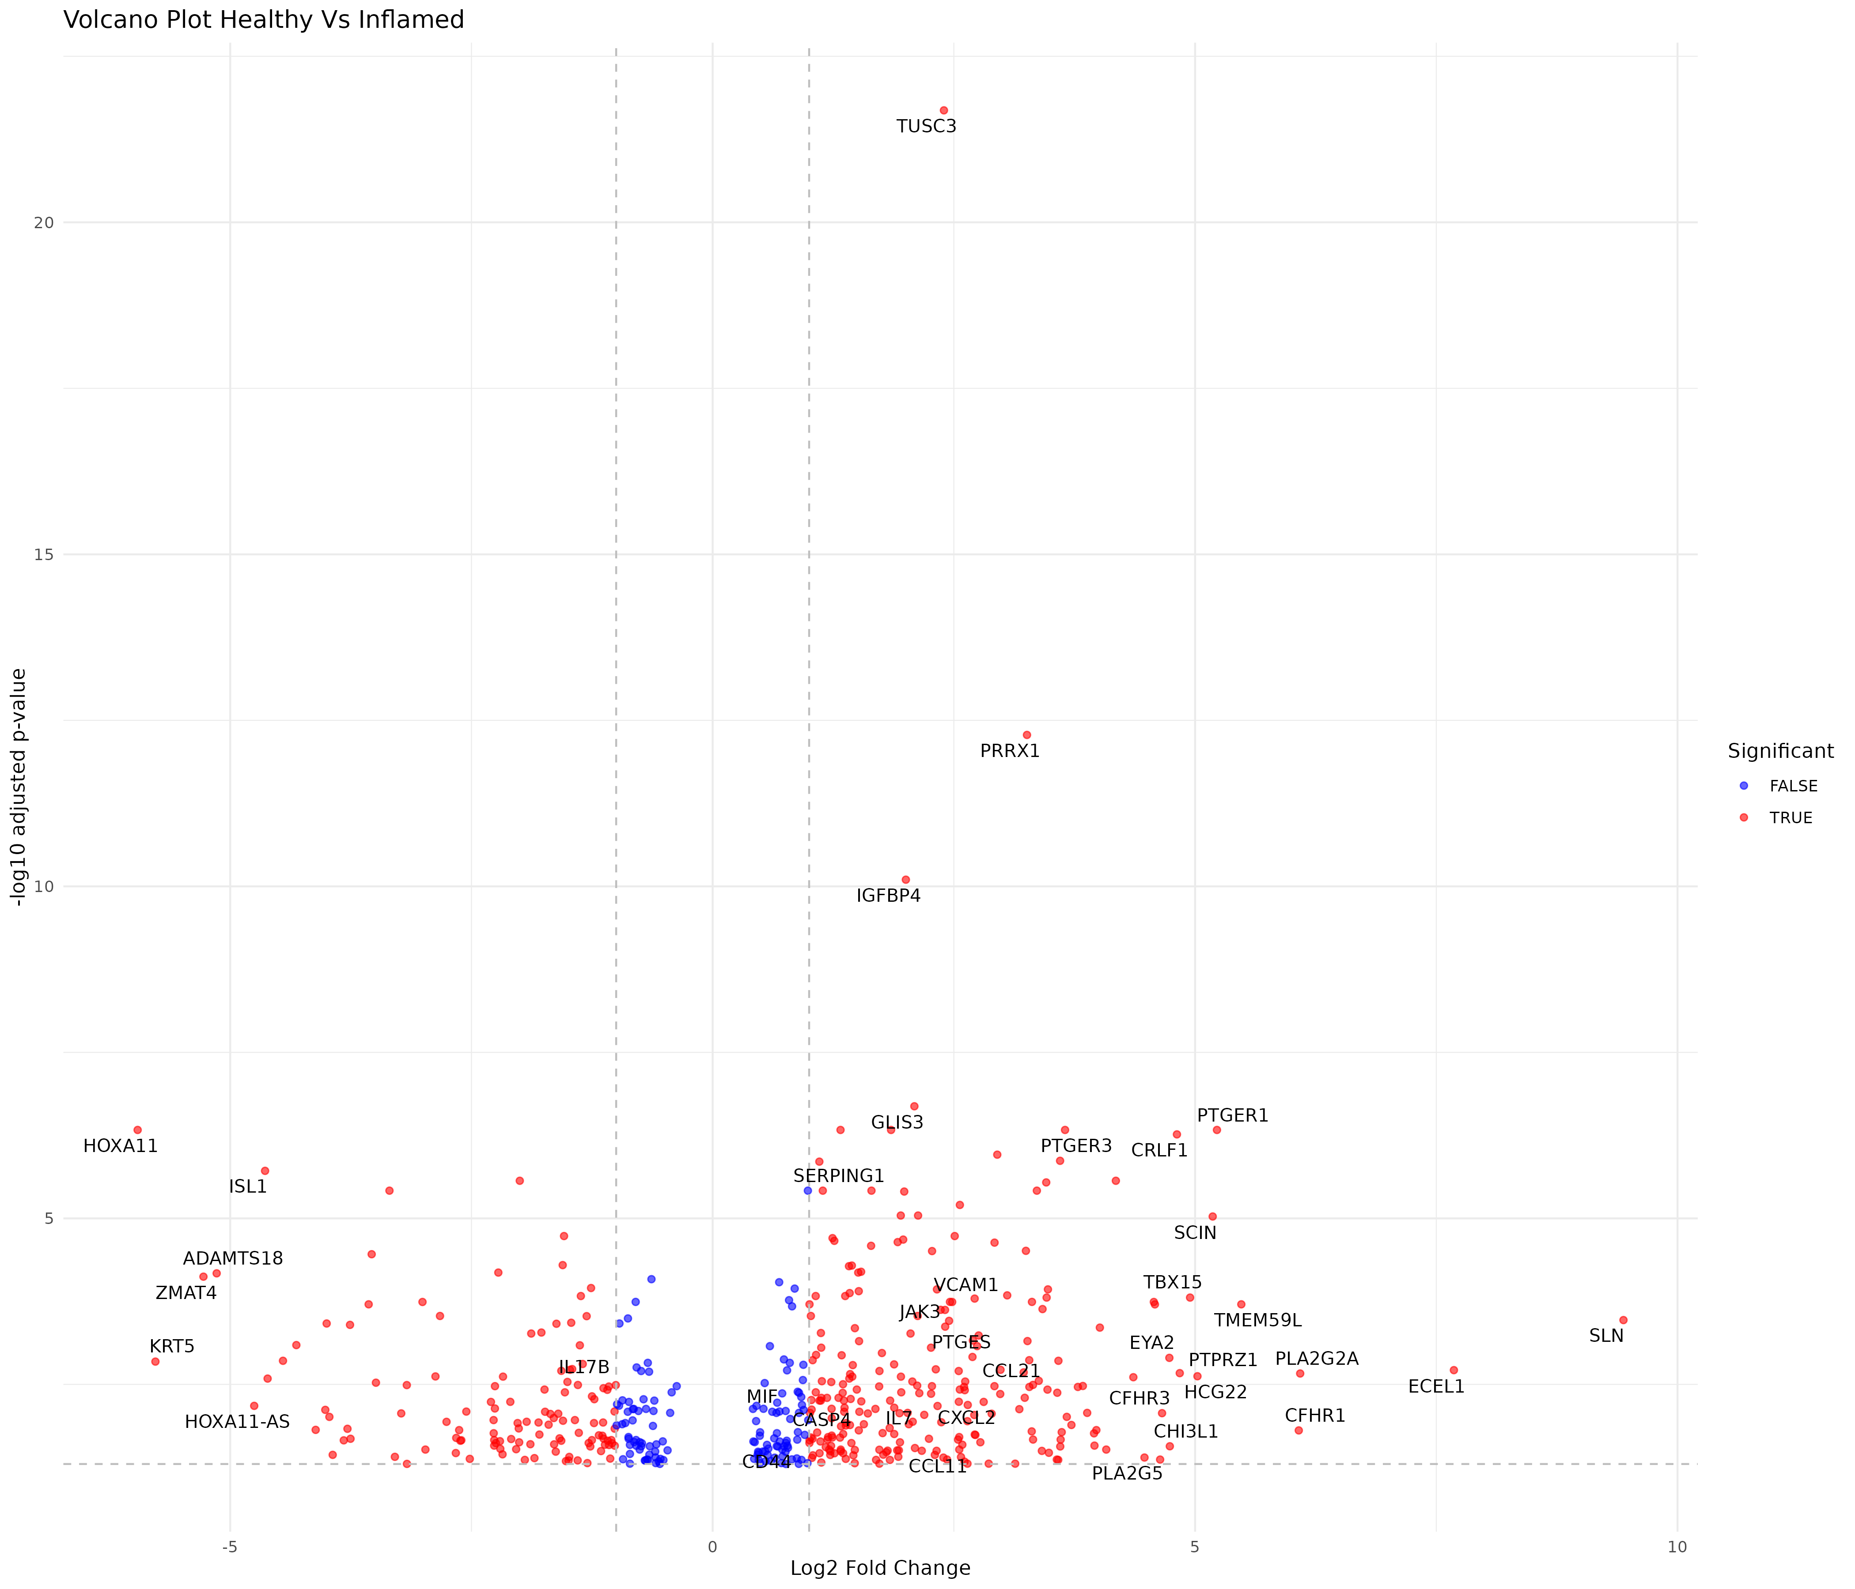

Slide 54
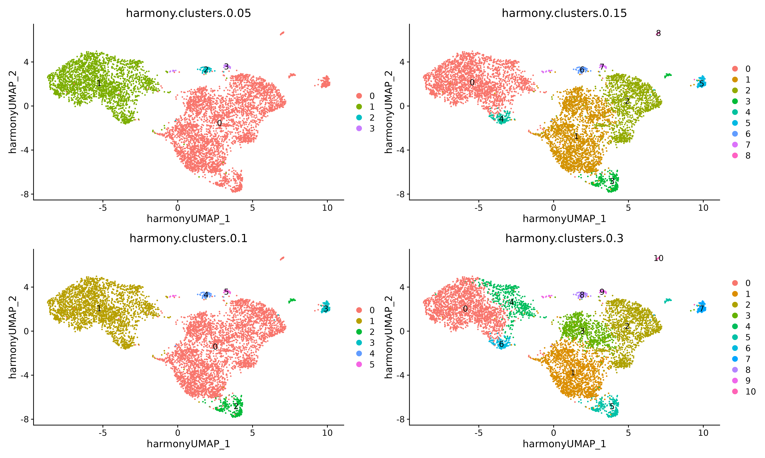
Clustering, Pericytes Subtypes and DCATS
Clustering process
One of the objectives is to find different subpopulation of pericytes
FindNeighbors
FindClusters
UMAP
Choose Resolution
We are alrady working with only one cell type, be careful with overclusterizing

Slide 55
Clustering, Pericytes Subtypes and DCATS
Clustering process
One of the objectives is to find different subpopulation of pericytes
FindNeighbors
FindClusters
UMAP
Choose Resolution
We are alrady working with only one cell type, be careful with overclusterizing

Slide 56
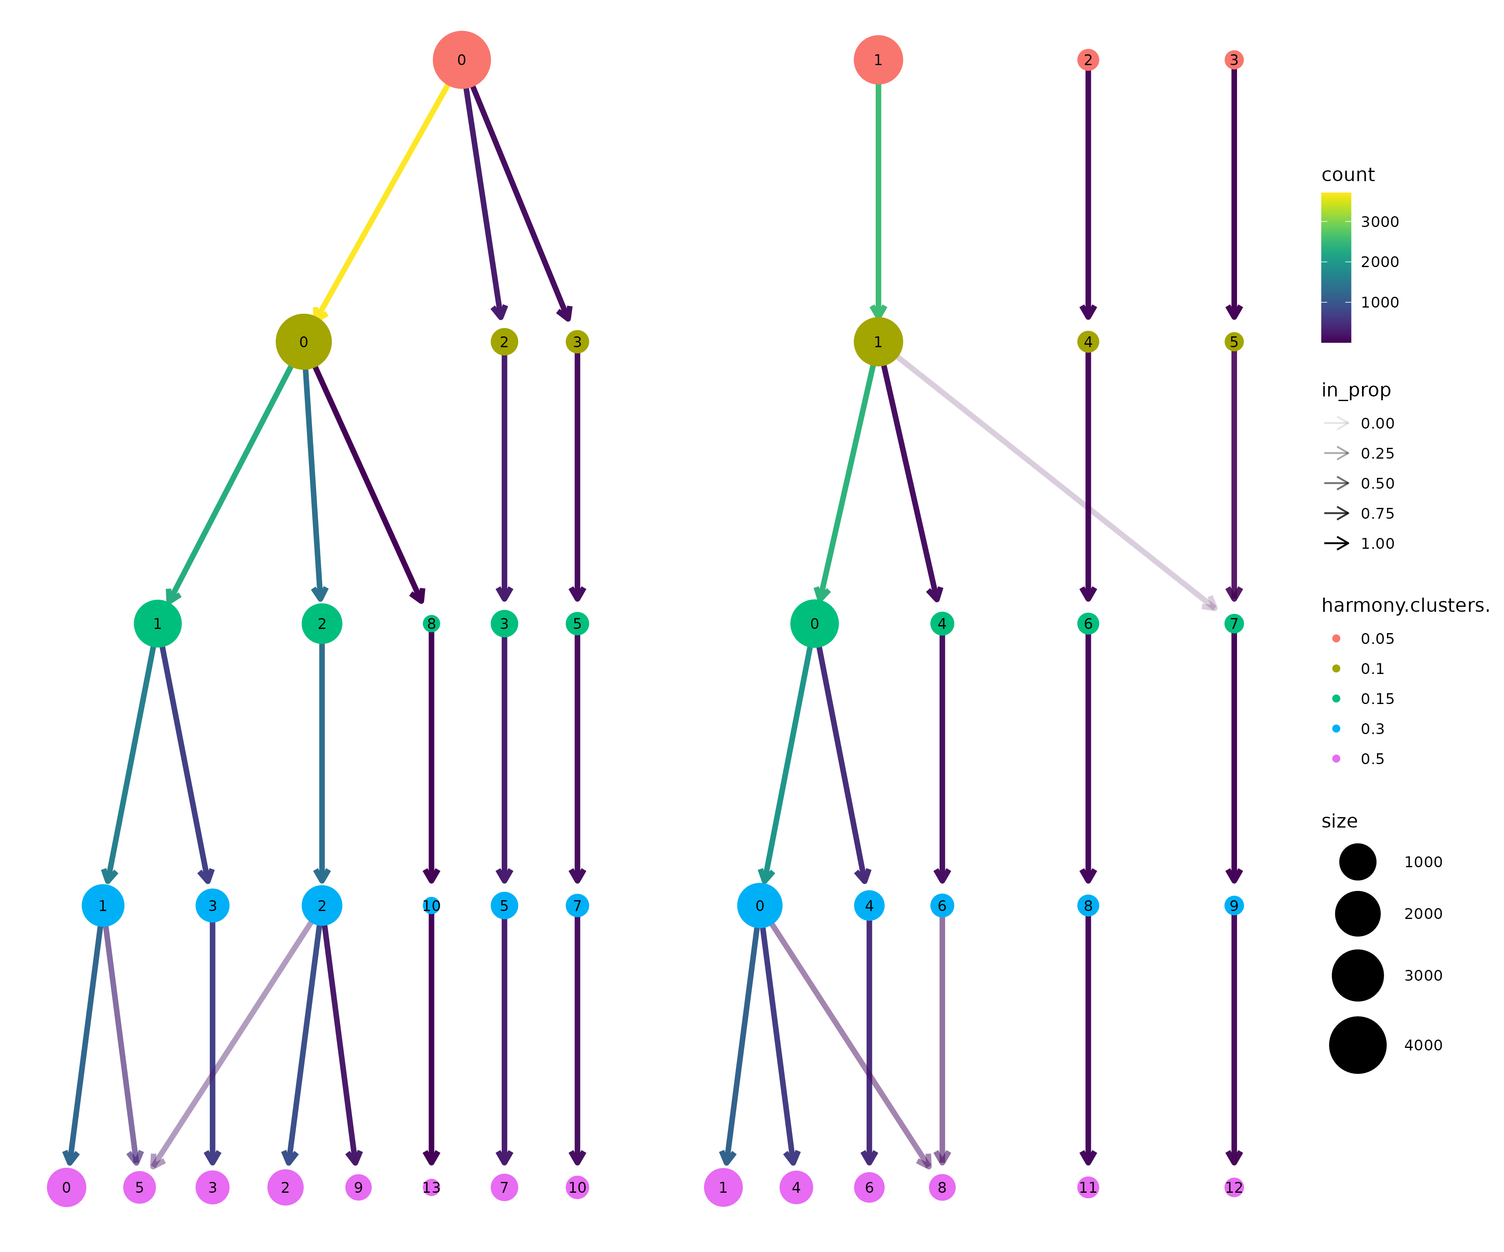
Clustering, Pericytes Subtypes and DCATS
Clustering process
Slightly modify the clustering to avoid unnecessary clusters and get as much Biological Information as possible

Slide 57
Clustering, Pericytes Subtypes and DCATS
Cluster 1 is highly populated in patients that showed a “High Inflammation” profile
Inflammation is not a binary on/off state, but rather a heterogeneous process. Across patients we observe different degrees and distinct ways of manifesting inflammation.
Therefore, could be a good idea to study the cluster population per patient.
Barplot with proportion of cells from cluster 1 per patient.

Slide 58
Clustering, Pericytes Subtypes and DCATS
Clustering process

Slide 59
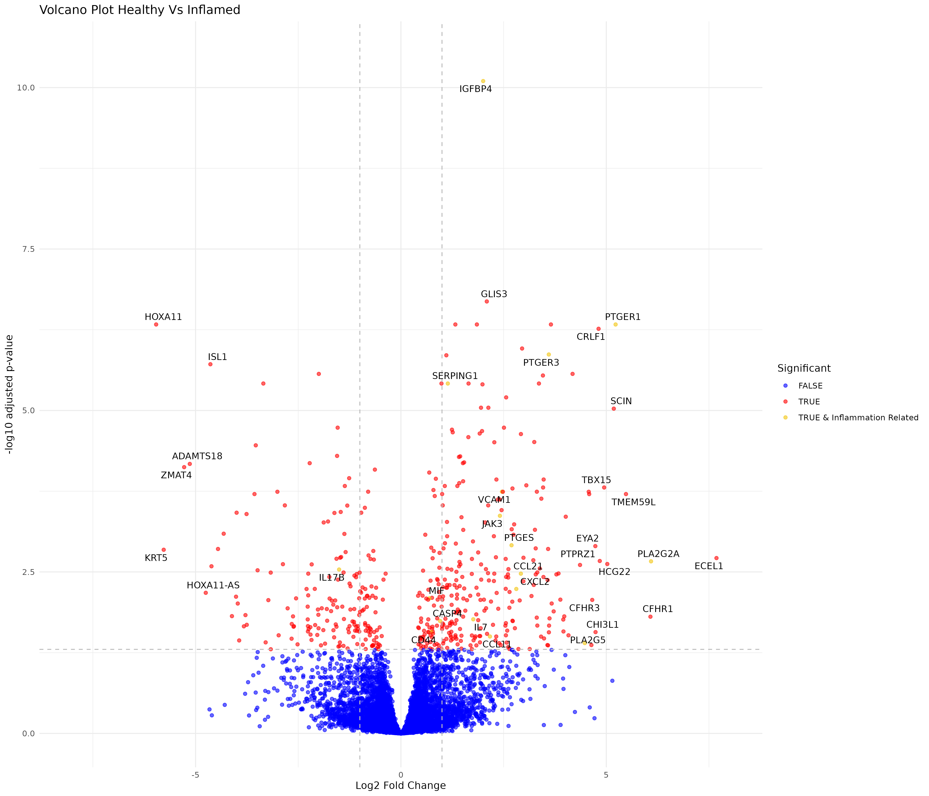
Differentially Expressed Genes (DEGs)
Several significantly disregulated Inflammation related genes:
Inflammatory mediators: PLA2 family, PTG family, CXCL2, IL7, JAK3 (IBD treatment target)…
Complement and Innate inmunity mediators: CFHR1, CFHR3, SERPING1…
Inmune Cell adhesion and tissue remodeling:
VCAM-1, CD44…
IGFBP4 elevation is associated with a chronical inflammatory state and exposure to pro-inflammatory cytokines

Slide 60

Differentially Expressed Genes (DEGs)
Several significantly disregulated Inflammation related genes:
Inflammatory mediators: PLA2 family, PTG family, CXCL2, IL7, JAK3 (IBD treatment target)…
Complement and Innate inmunity mediators: CFHR1, CFHR3, SERPING1…
Inmune Cell adhesion and tissue remodeling:
VCAM-1, CD44…
IGFBP4 elevation is associated with a chronical inflammatory state and exposure to pro-inflammatory cytokines

Slide 61
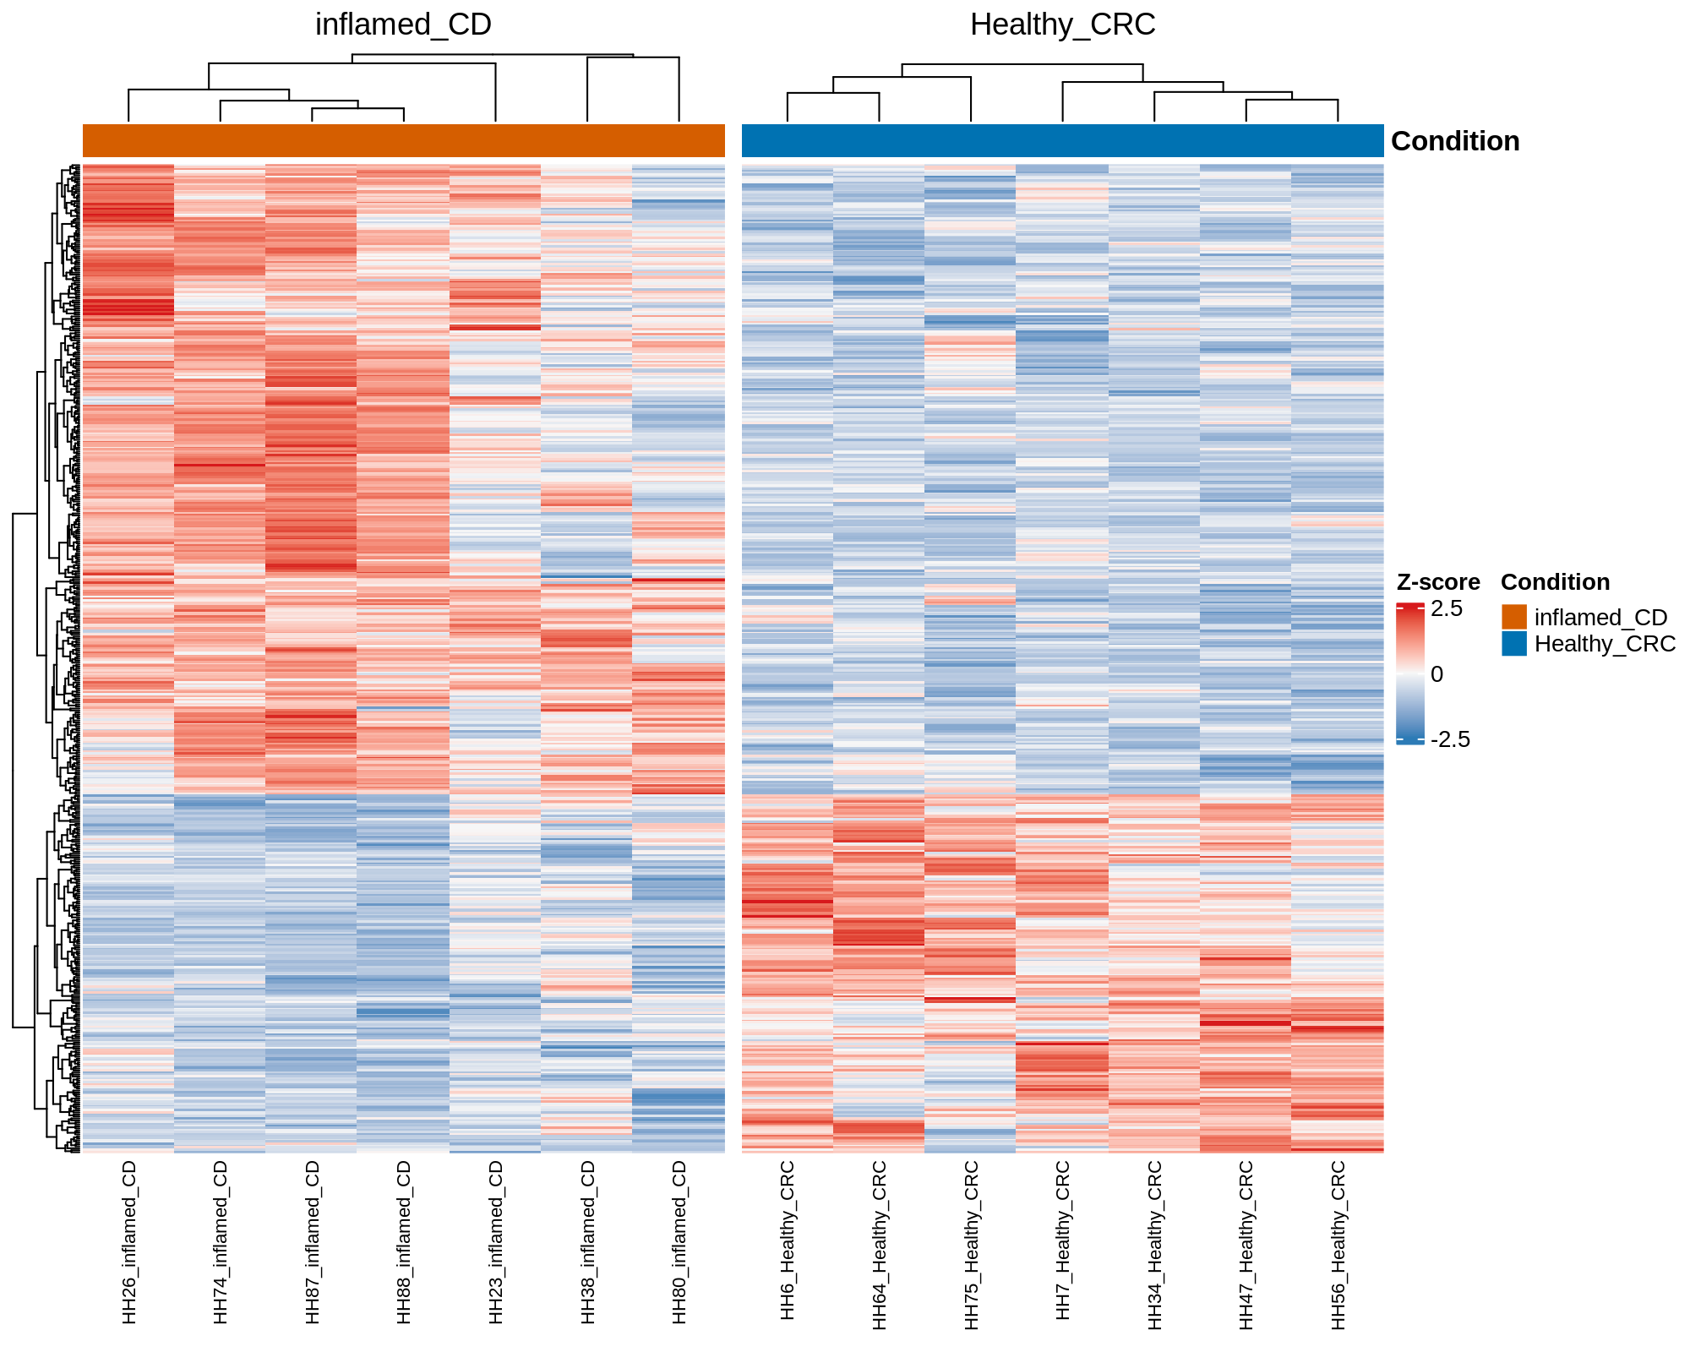
Differentially Expressed Genes (DEGs)
Recall we are dealing with possible Batch effects
Inflammation is a complex process that can manifest through different pathways
Check DEGs INDIVIDUALLY
Look for expression patterns
Study Batch effects

Slide 62
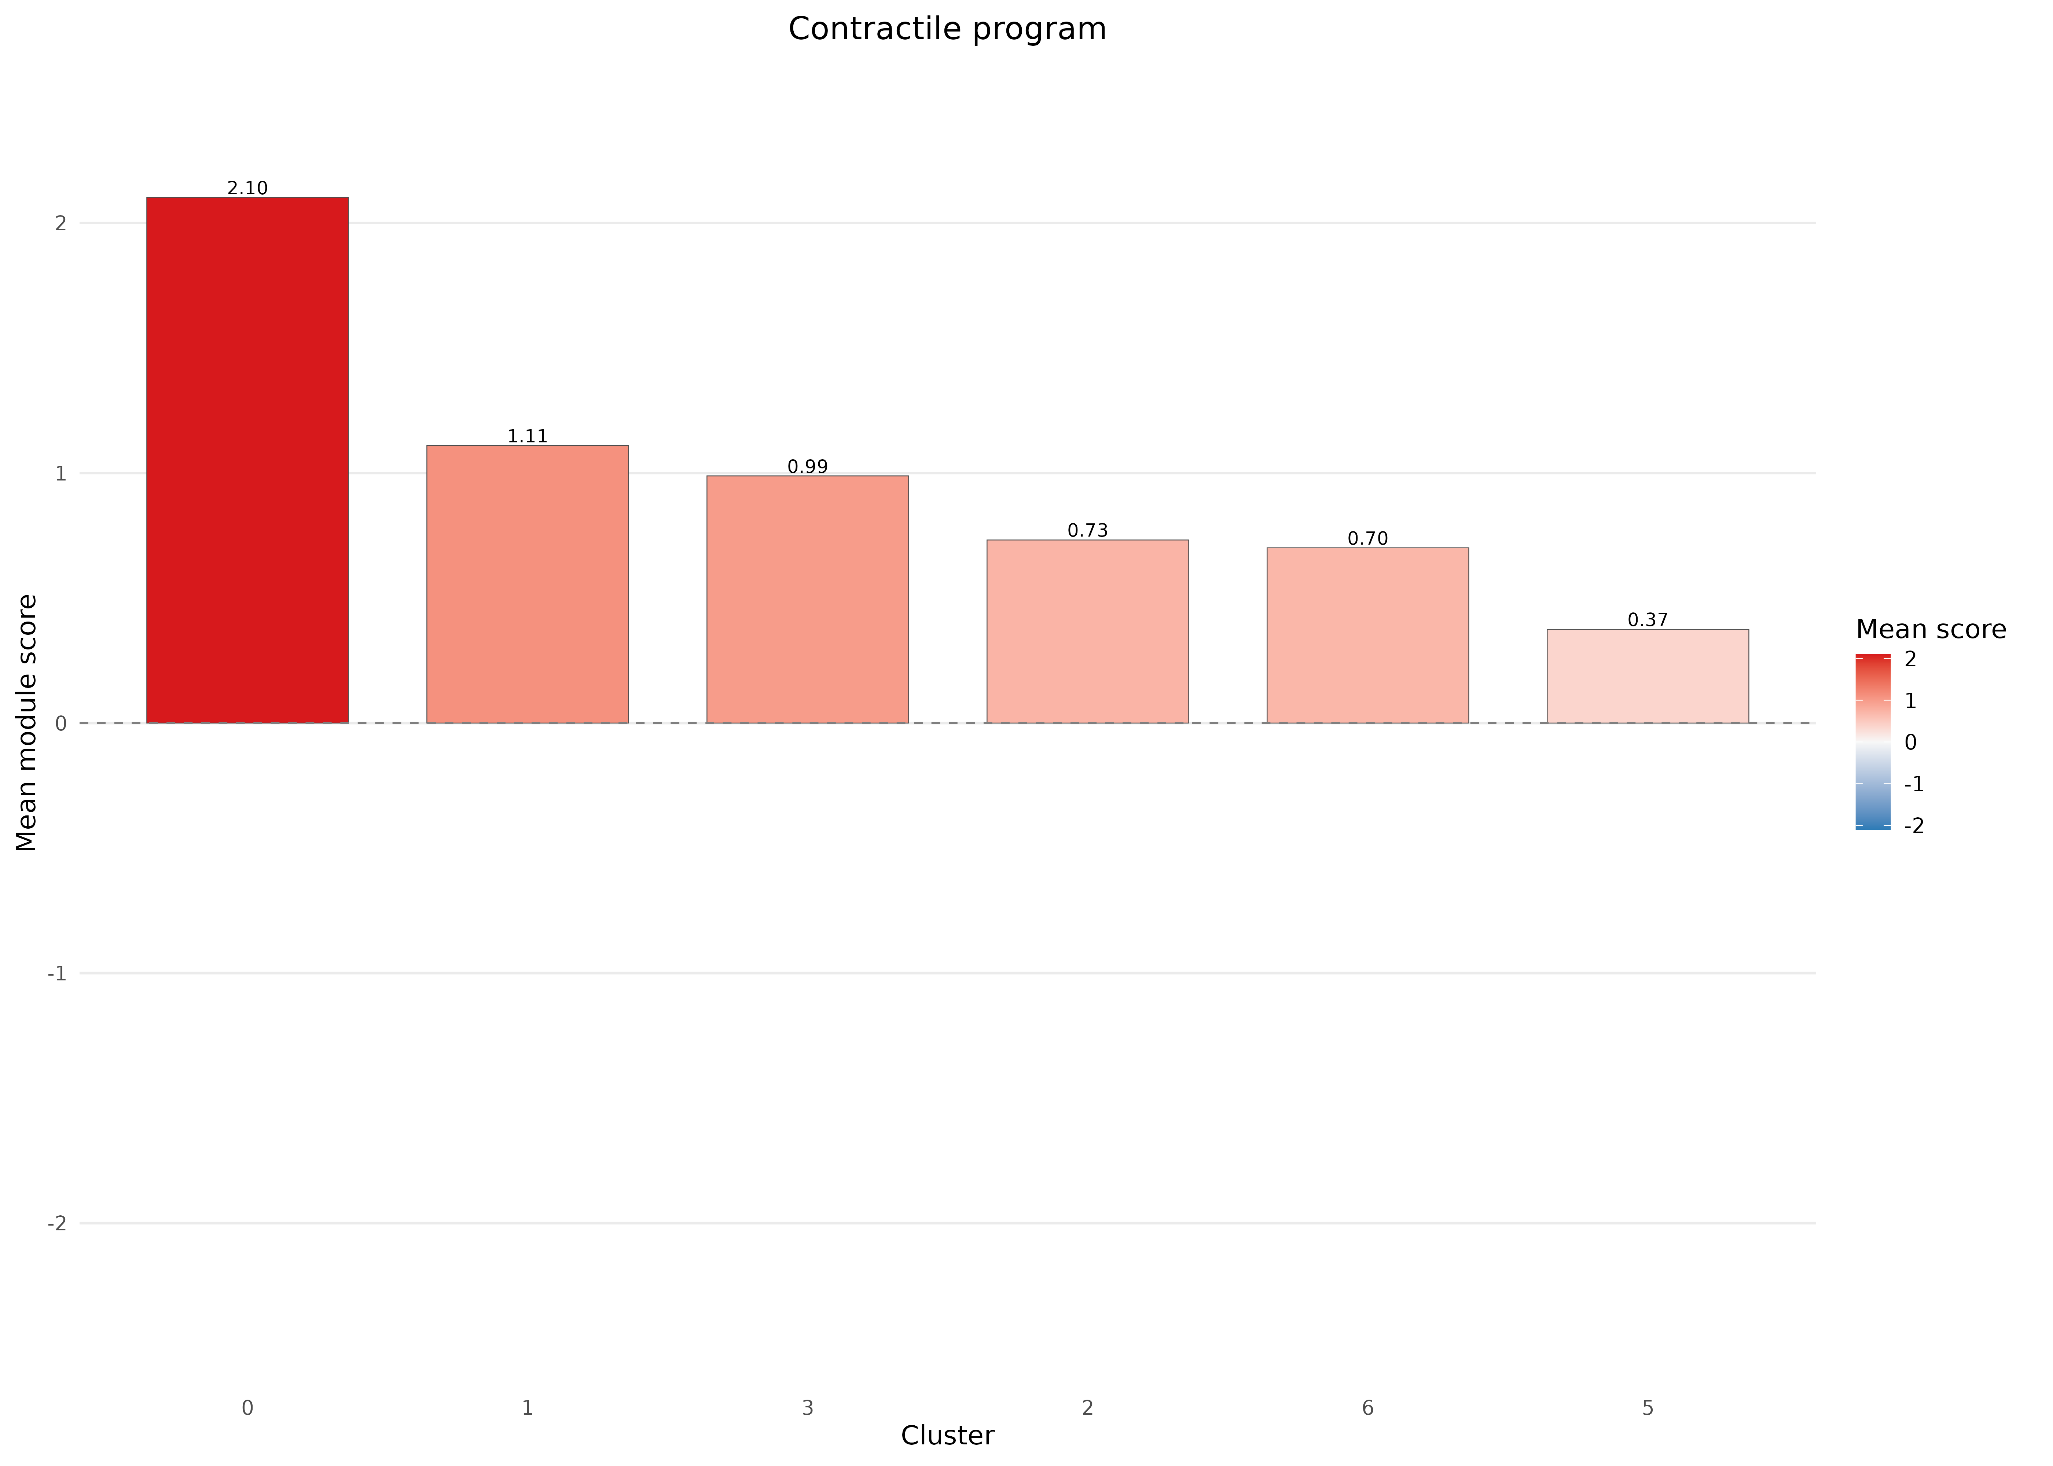
Contractile pericytes

Slide 63
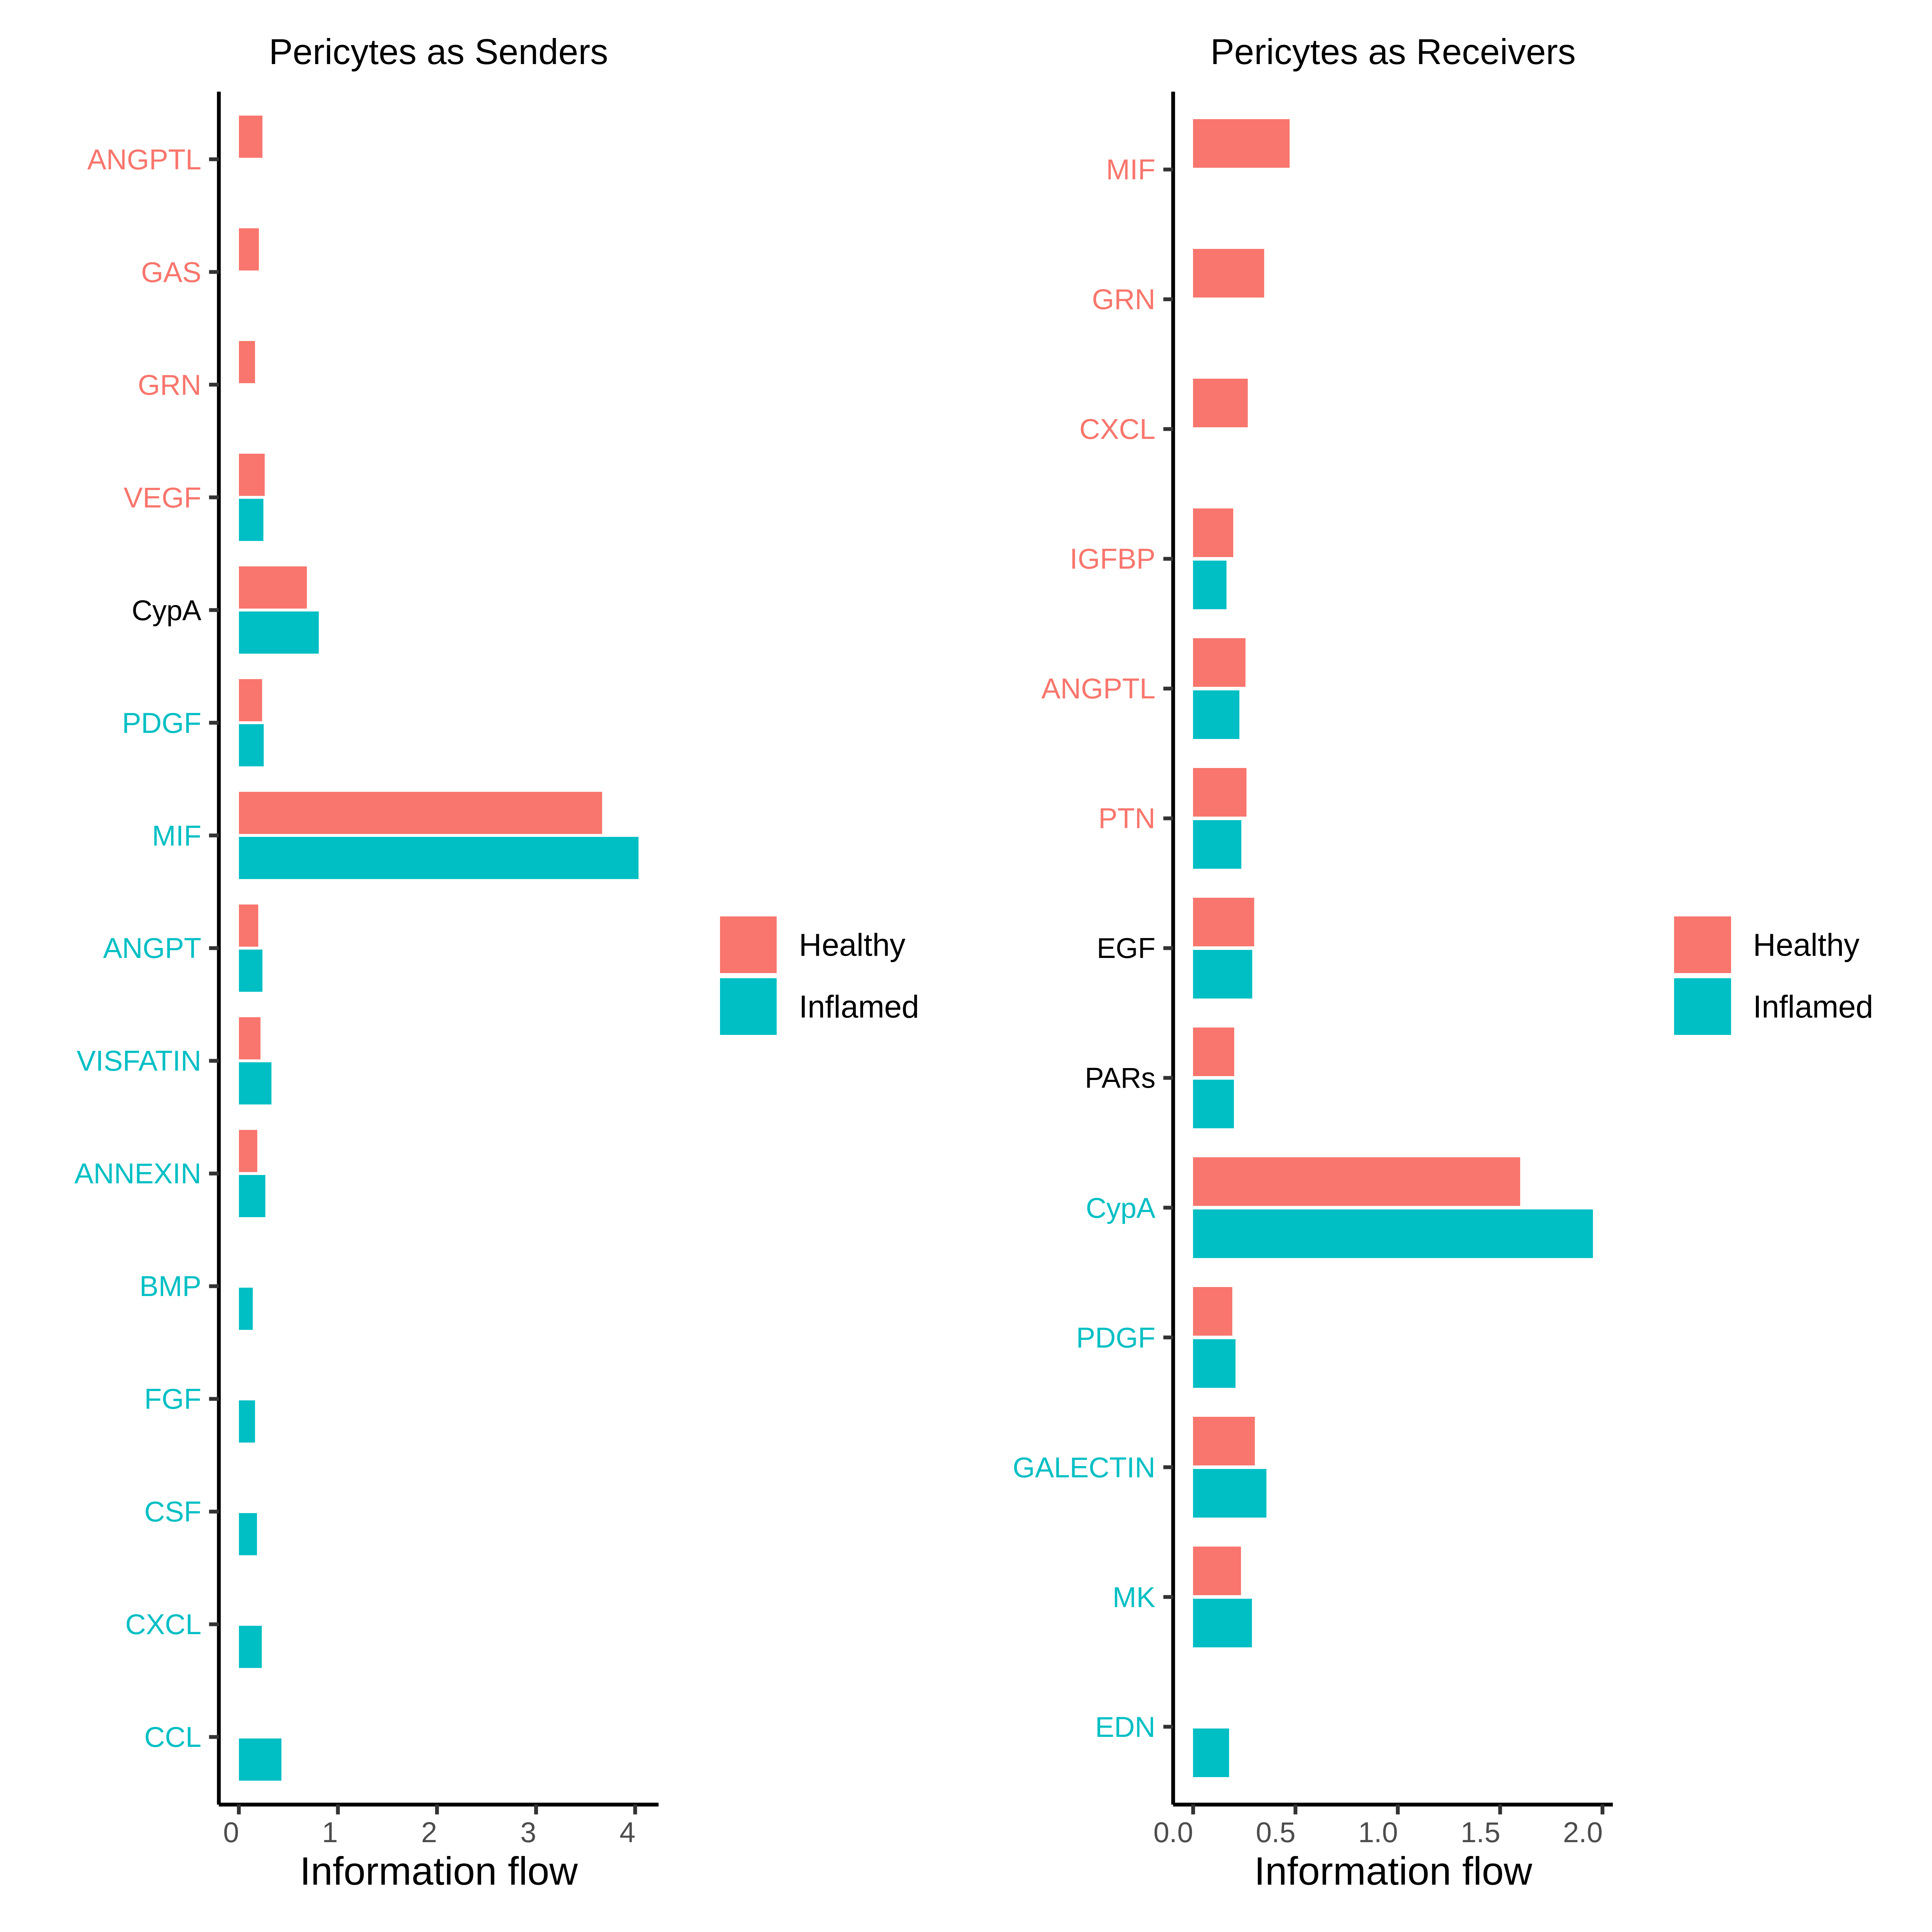
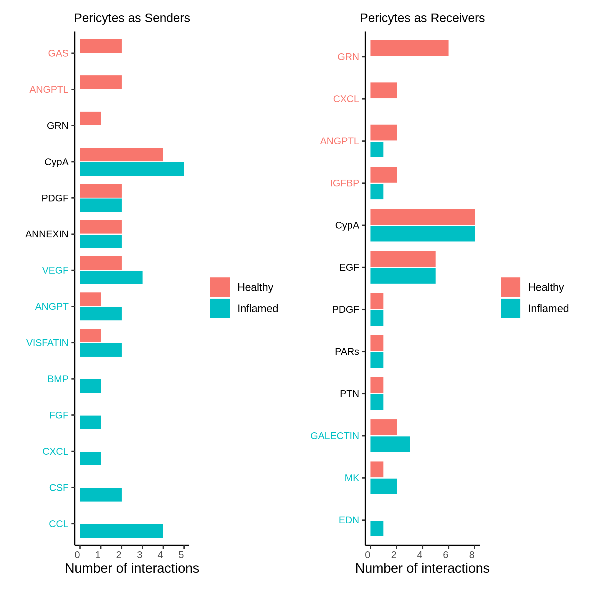
Cell to Cell Communication Network

Slide 64
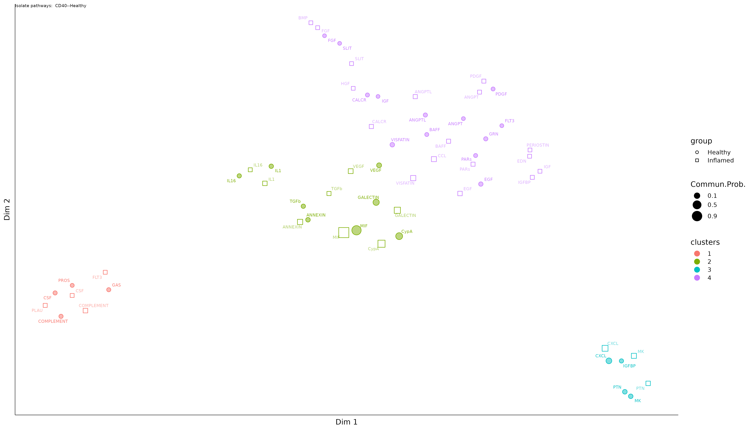
Cell to Cell Communication Network
Cellype Function UMAP

Slide 65
Cell to Cell Communication Network
Heatmap

